Slide 1
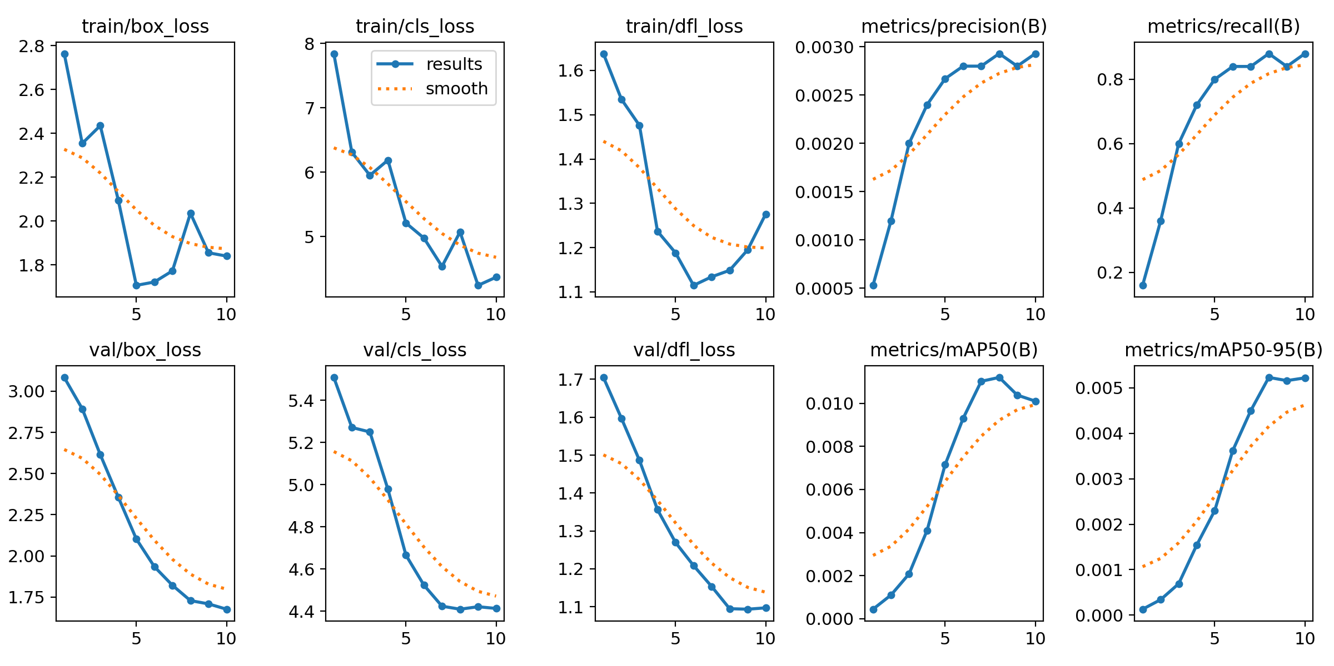
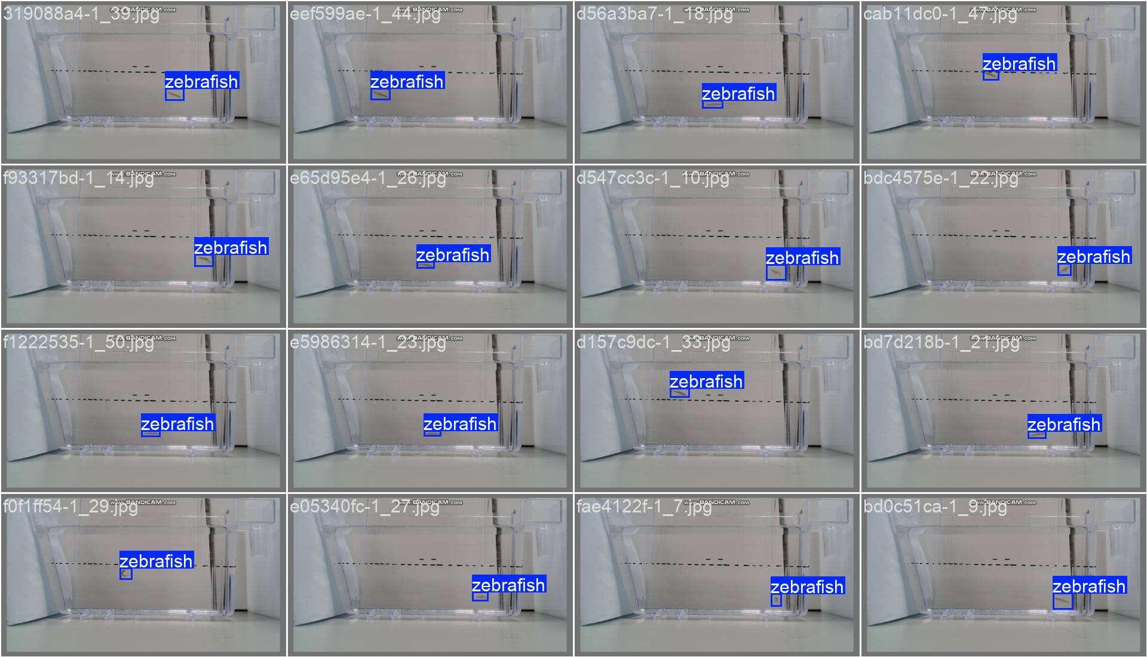
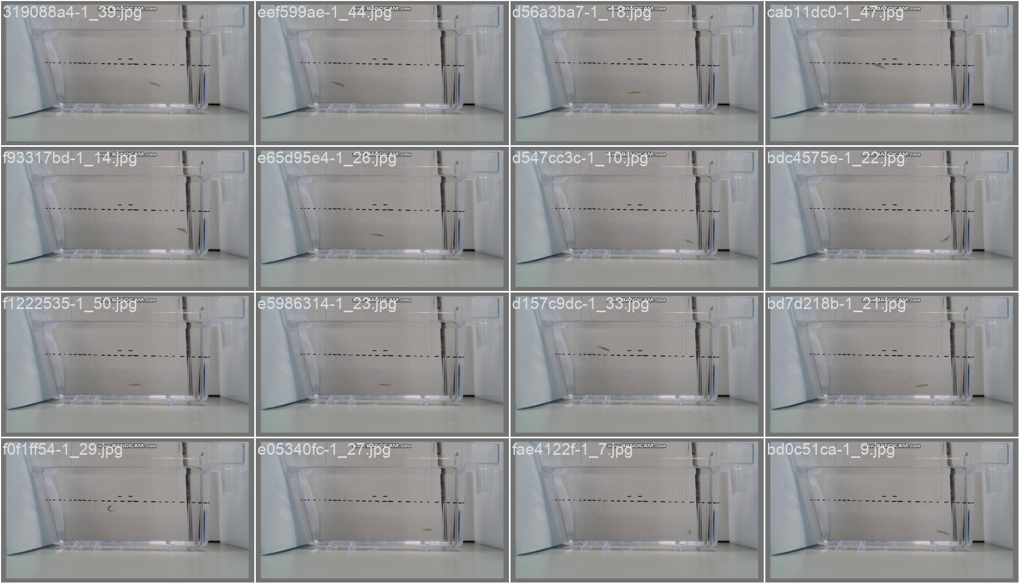
Mydataset 25pictures
Train 1
task: detect
mode: train
model: yolo11n.yaml
data: D:/Test_File/Code/Zebrafish-NTT-AI-Model/mydataset.yaml
epochs: 10
time: null
patience: 100
batch: 16
imgsz: 640

Slide 2
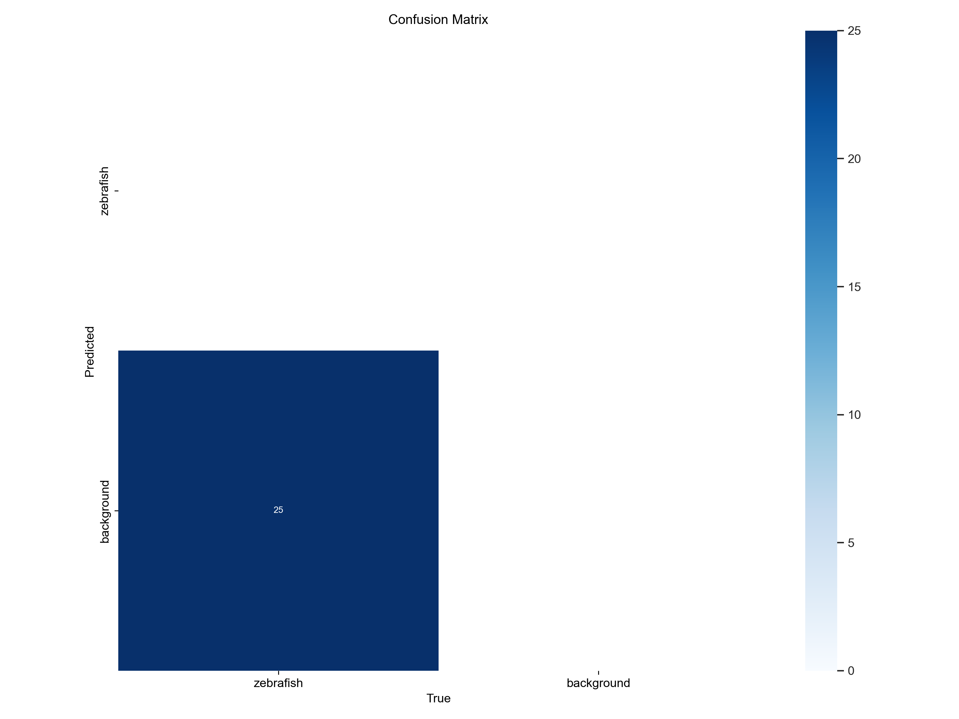
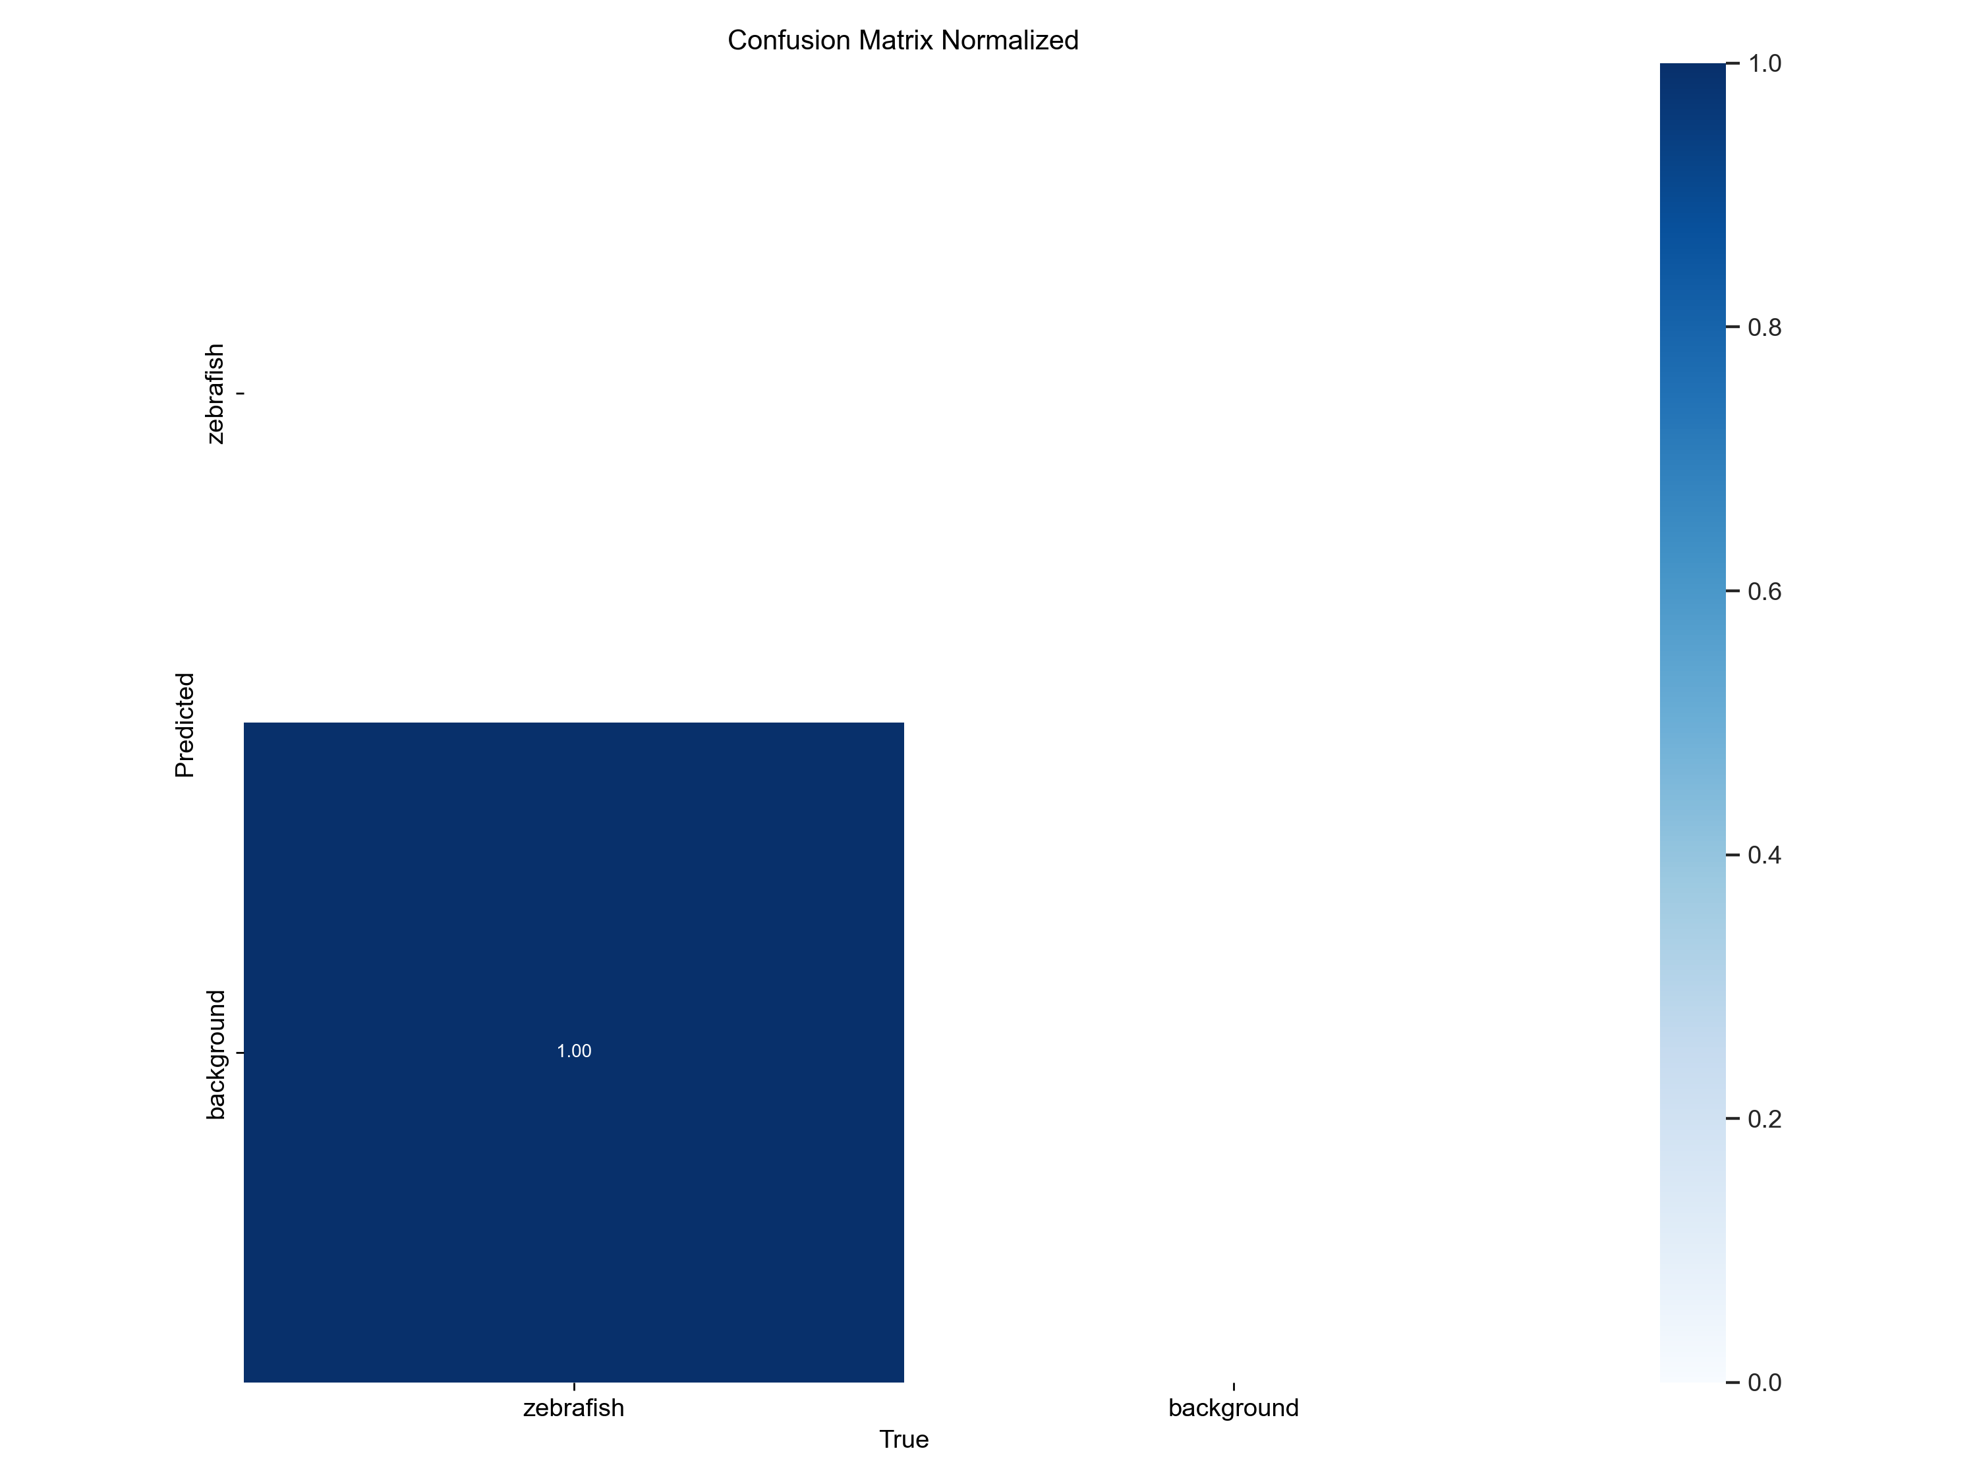
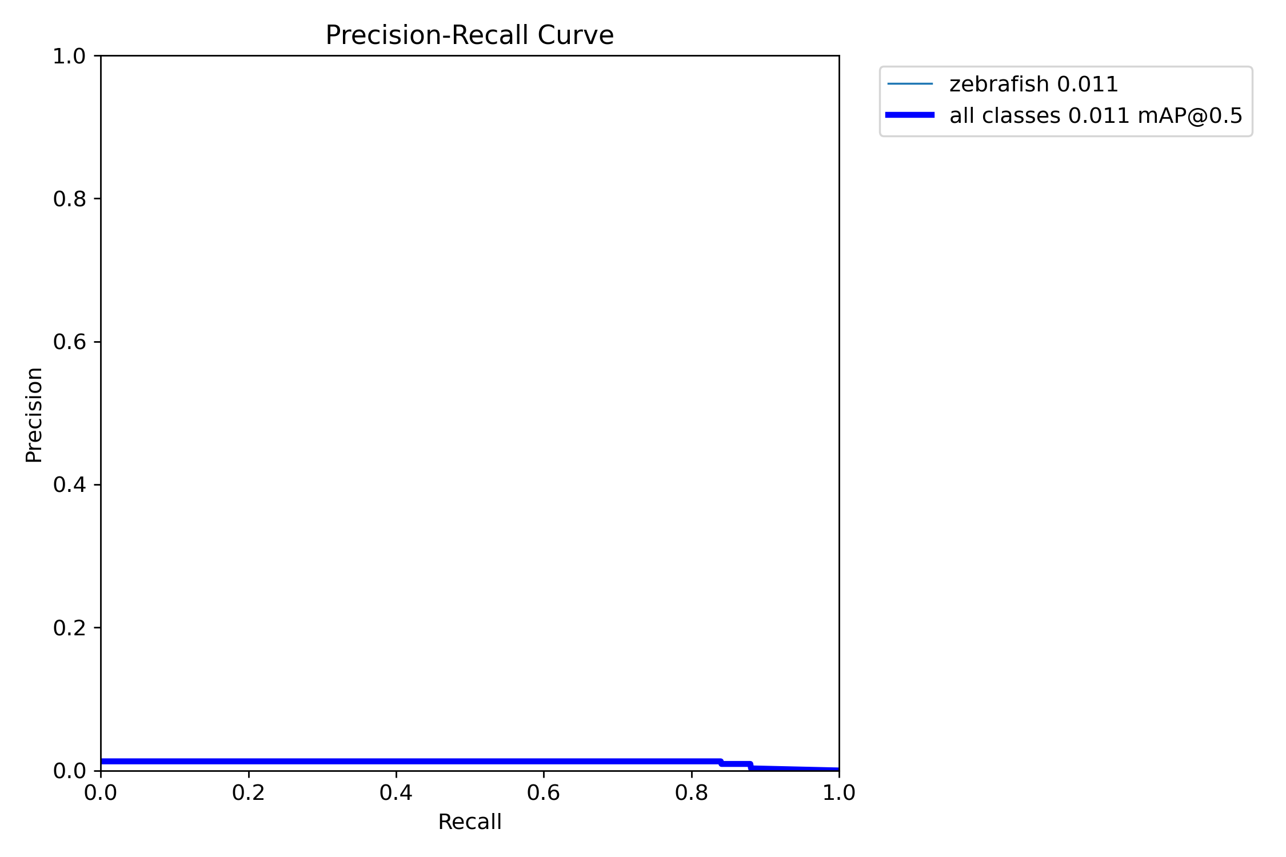
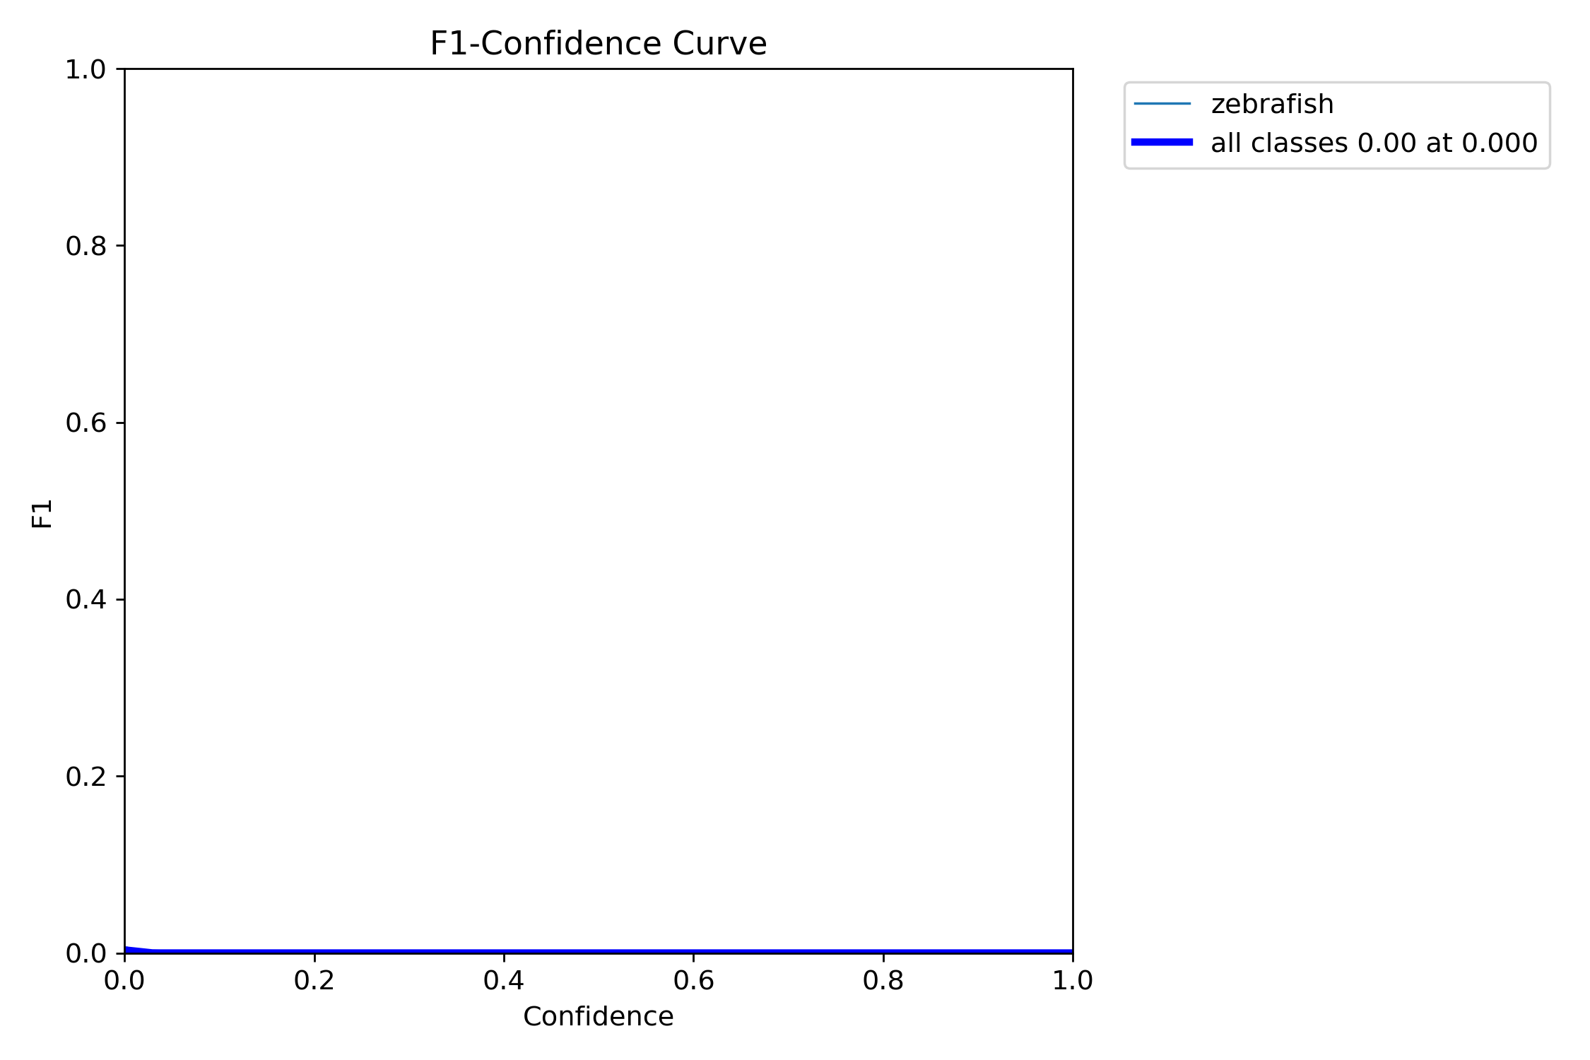
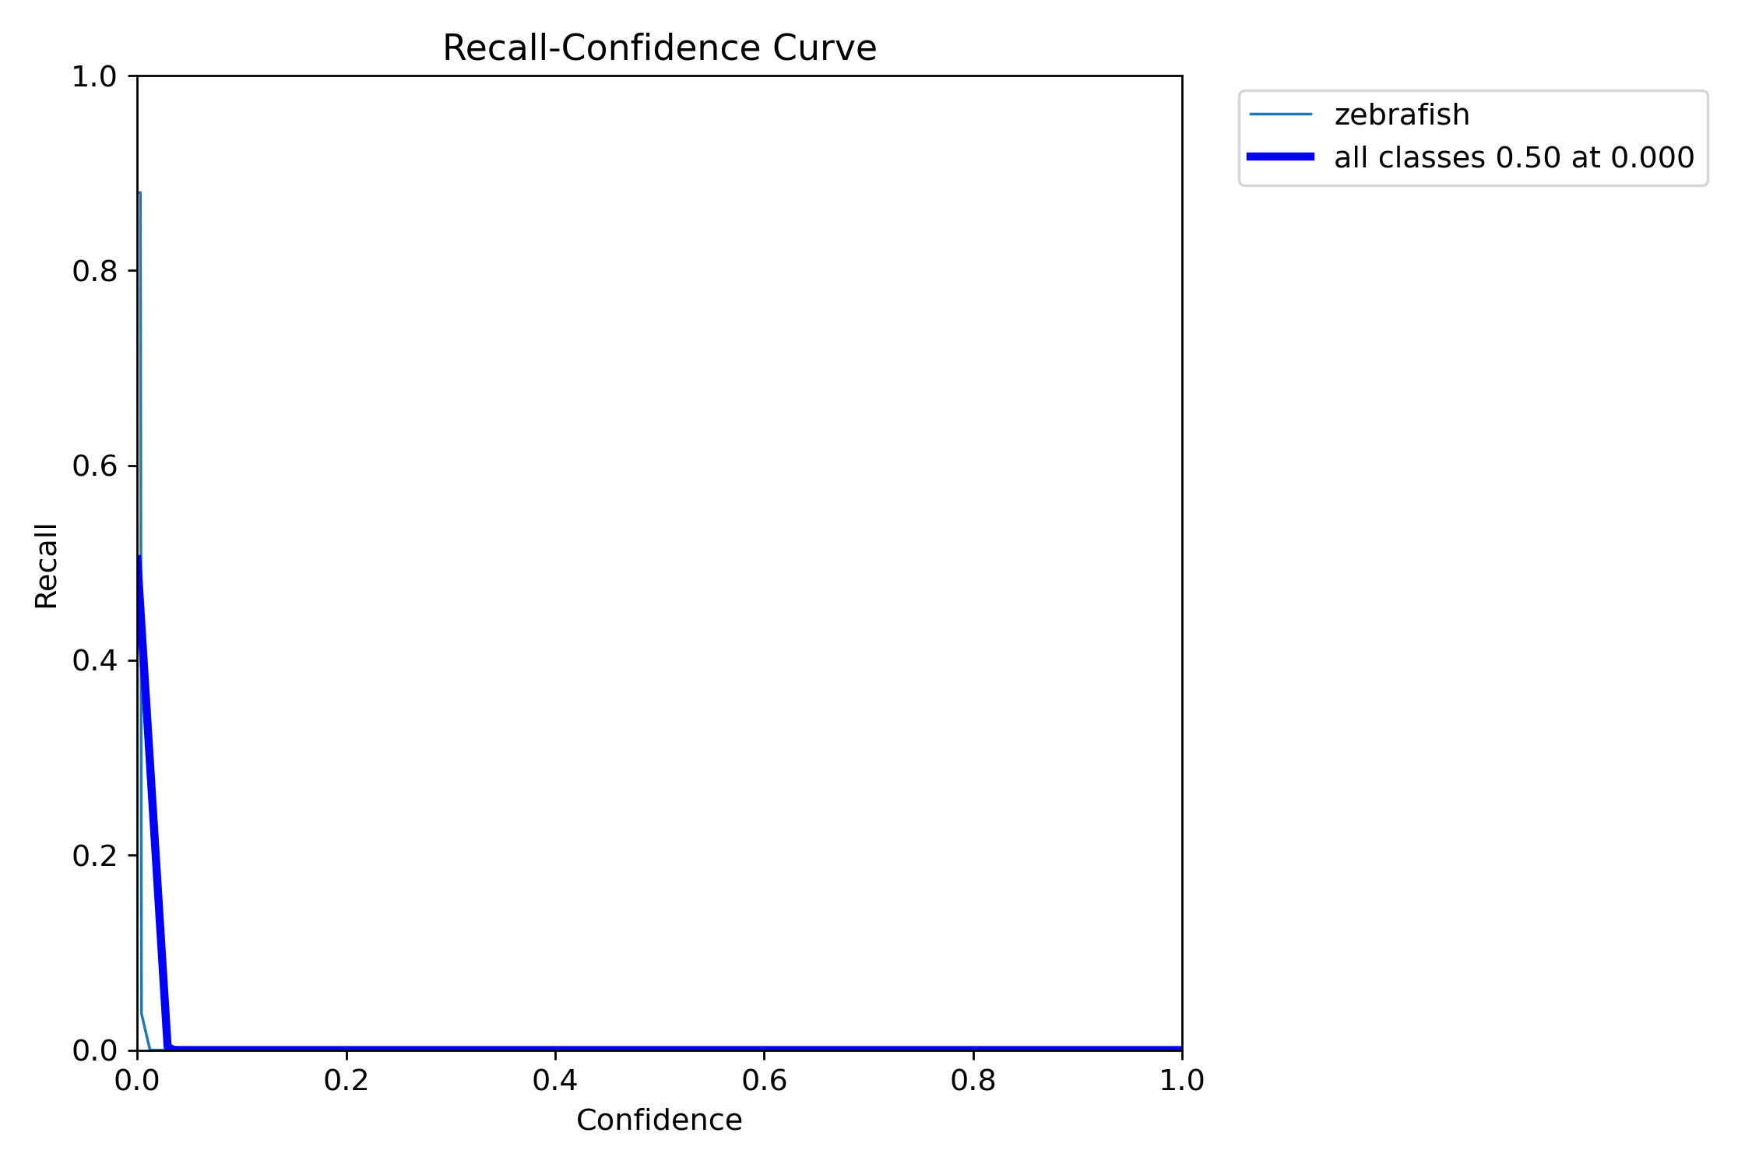
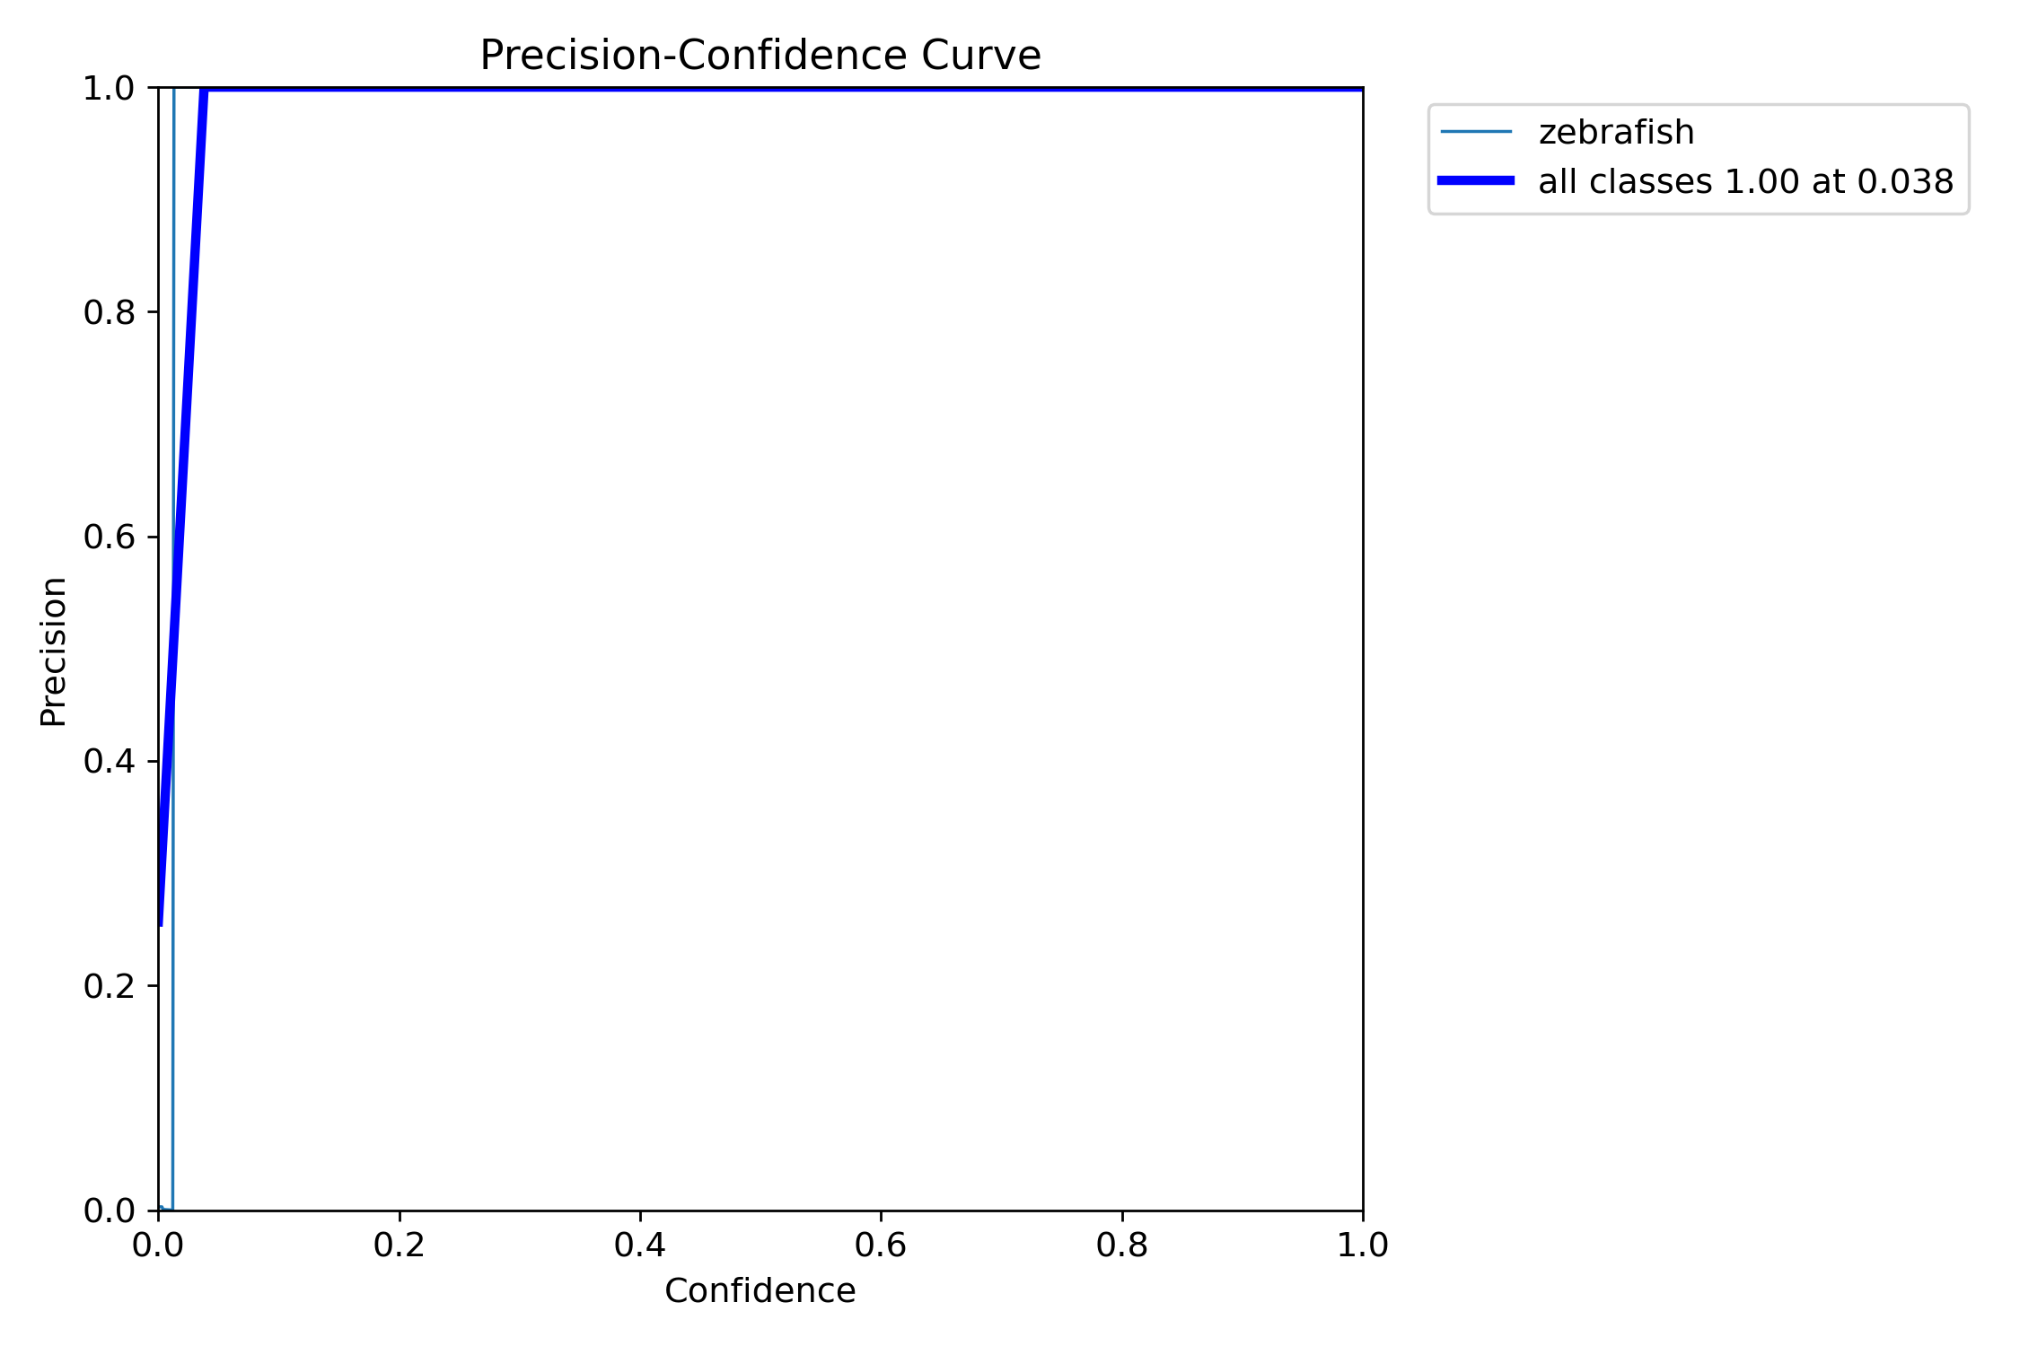

Slide 3
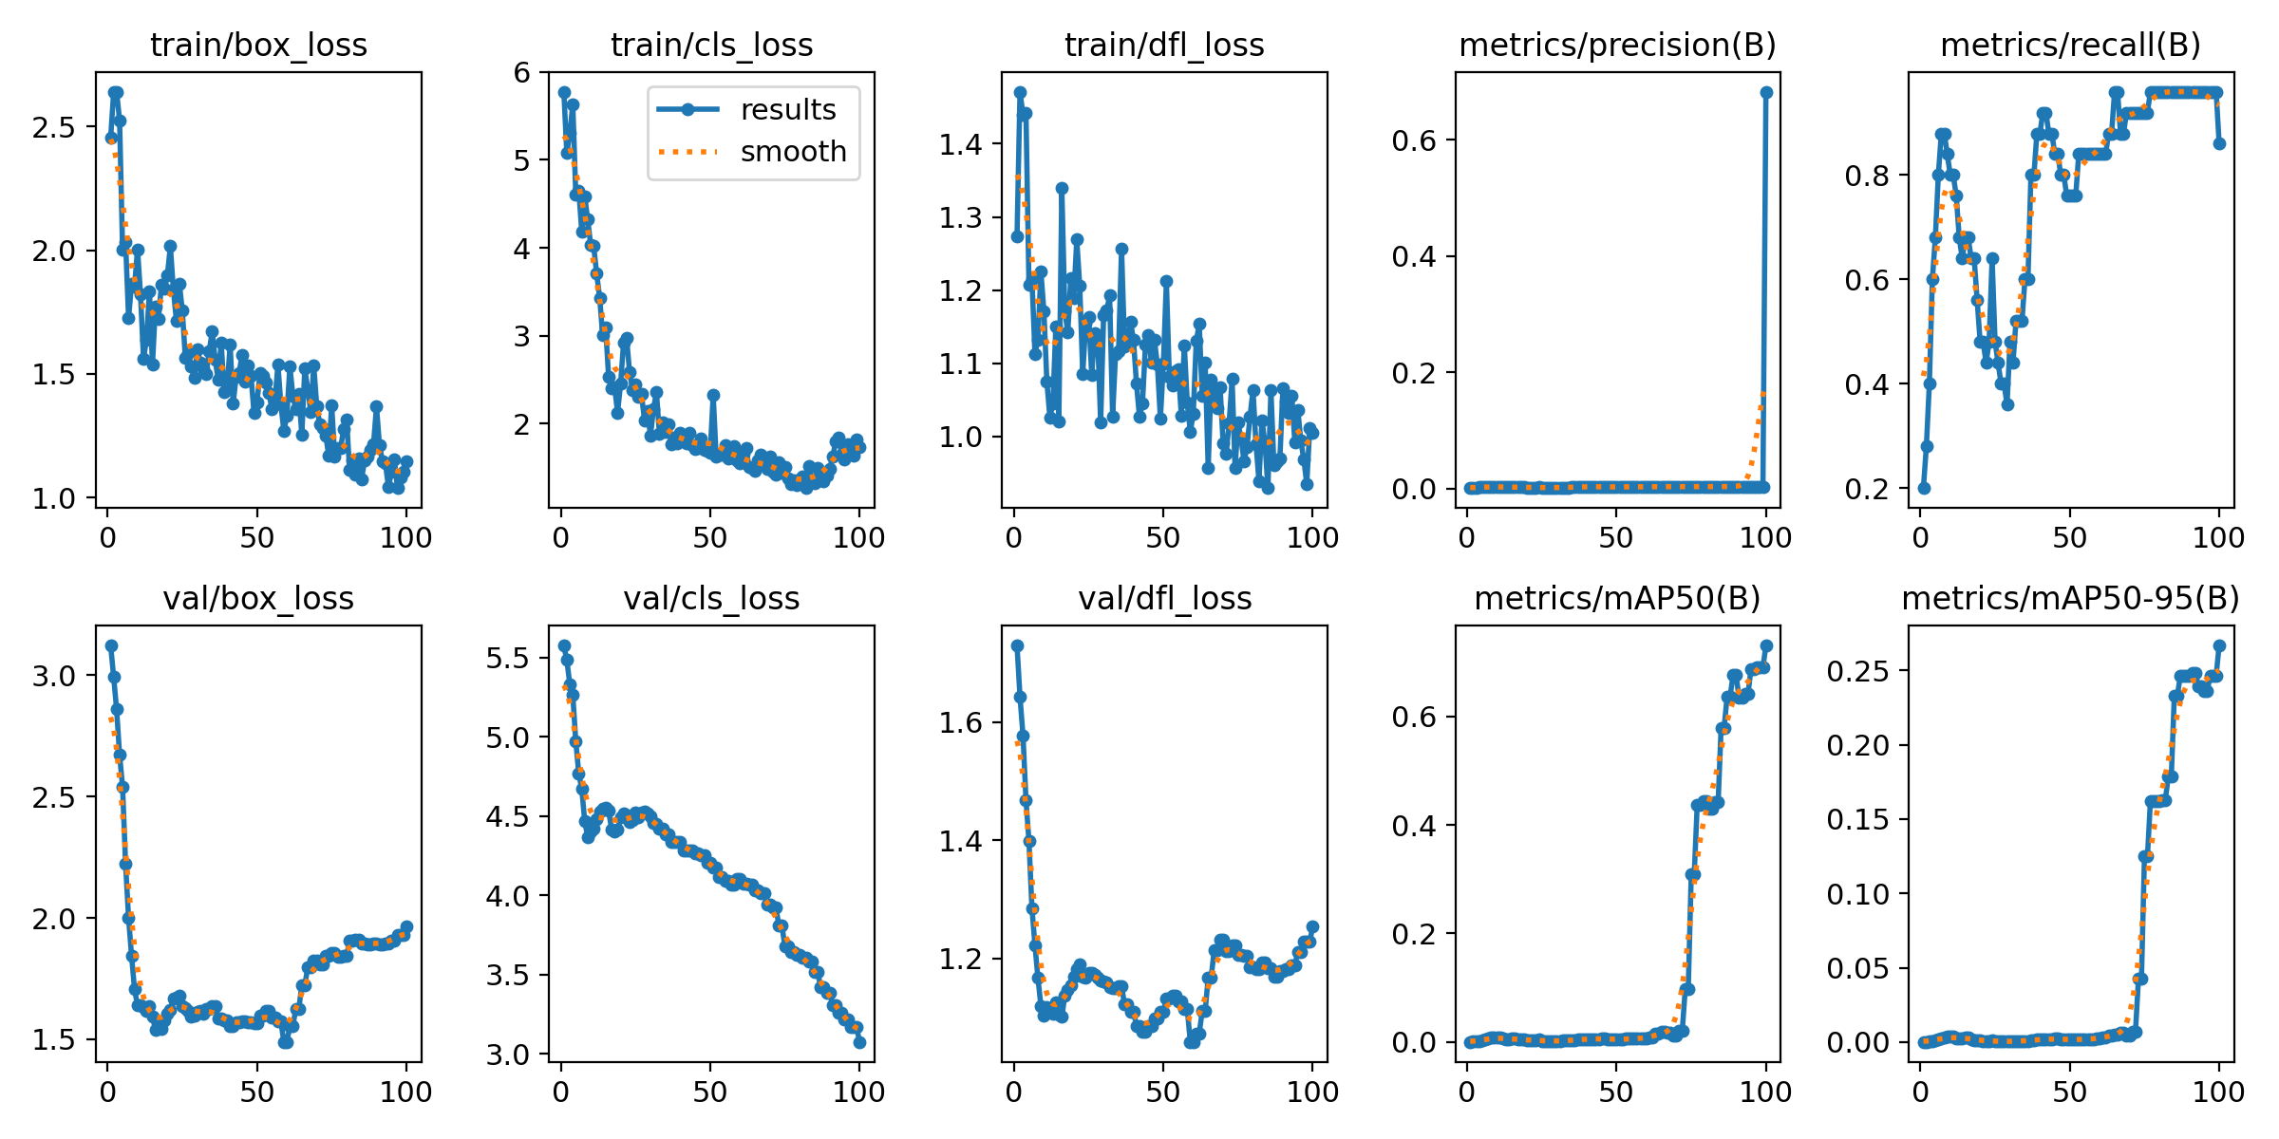
Mydataset 25pictures
Train 5
task: detect
mode: train
model: yolo11n.yaml
data: D:/Test_File/Code/Zebrafish-NTT-AI-Model/mydataset.yaml
epochs: 100
time: null
patience: 100
batch: 25
imgsz: 640

Slide 4
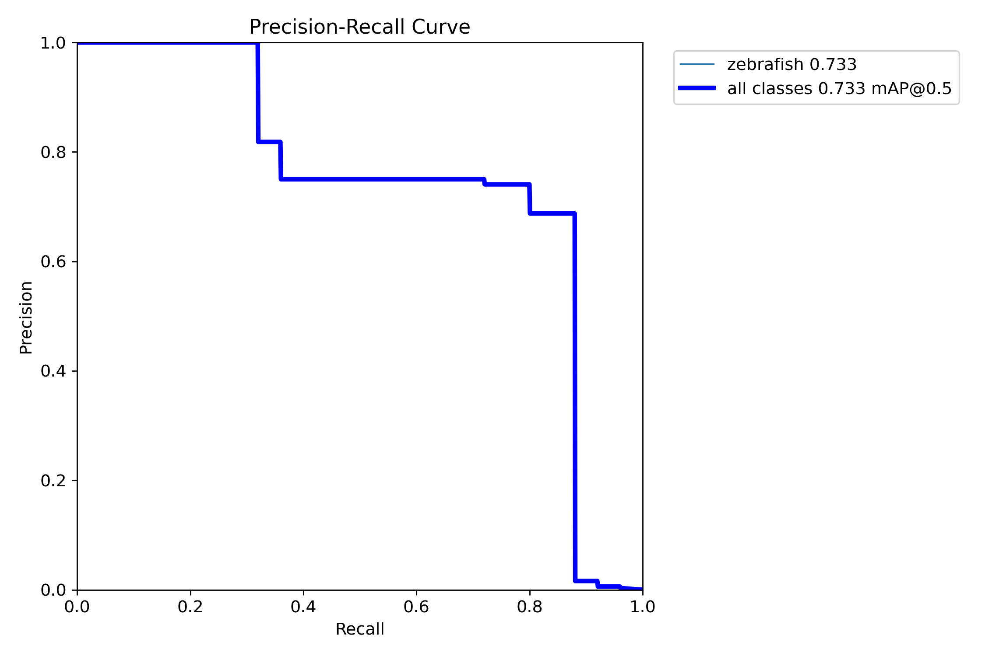
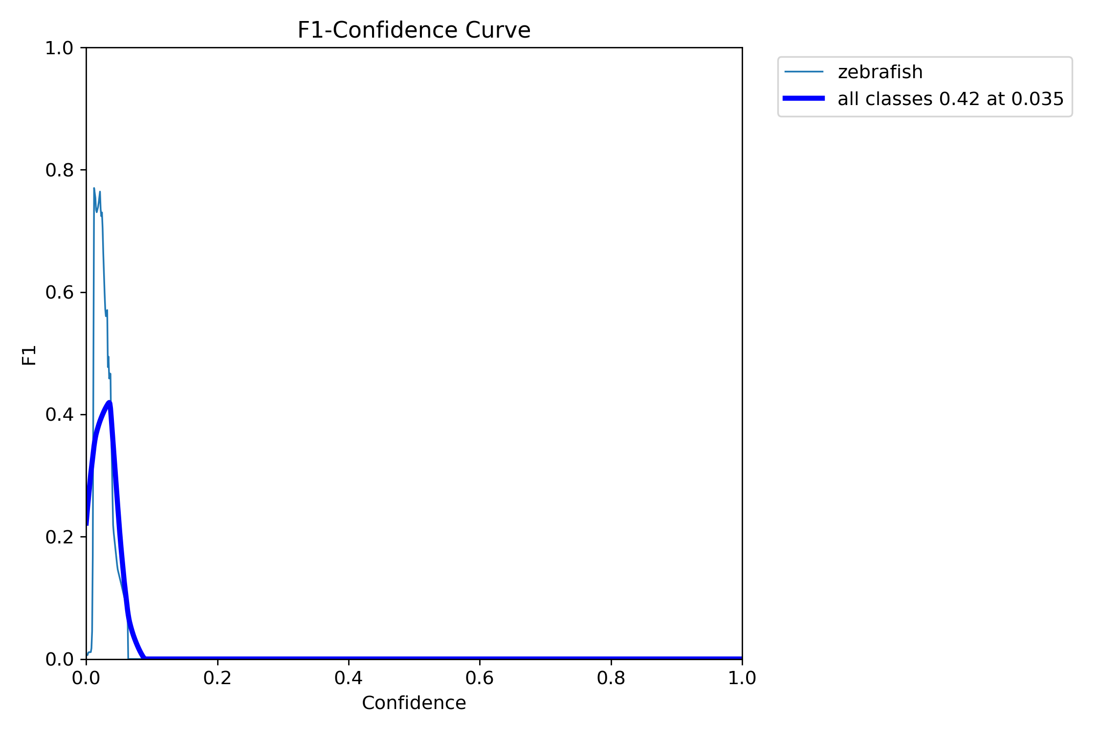
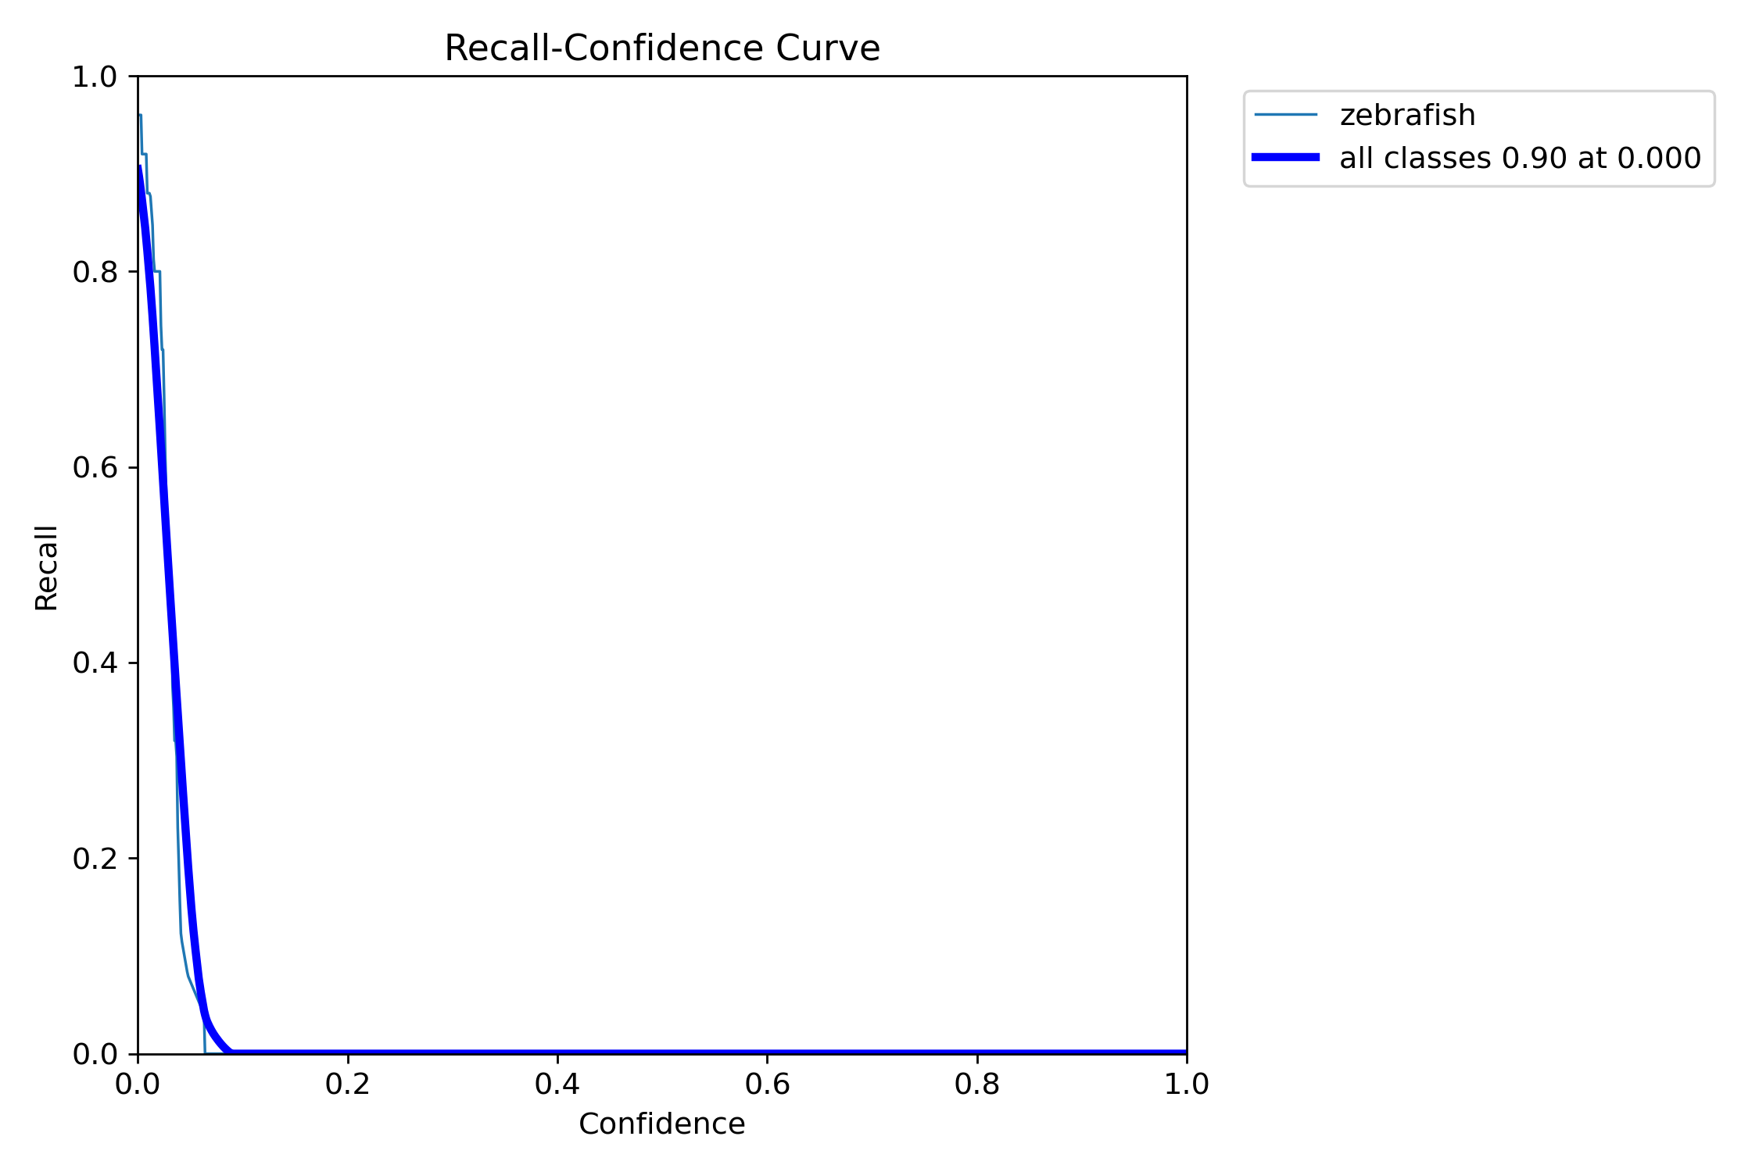
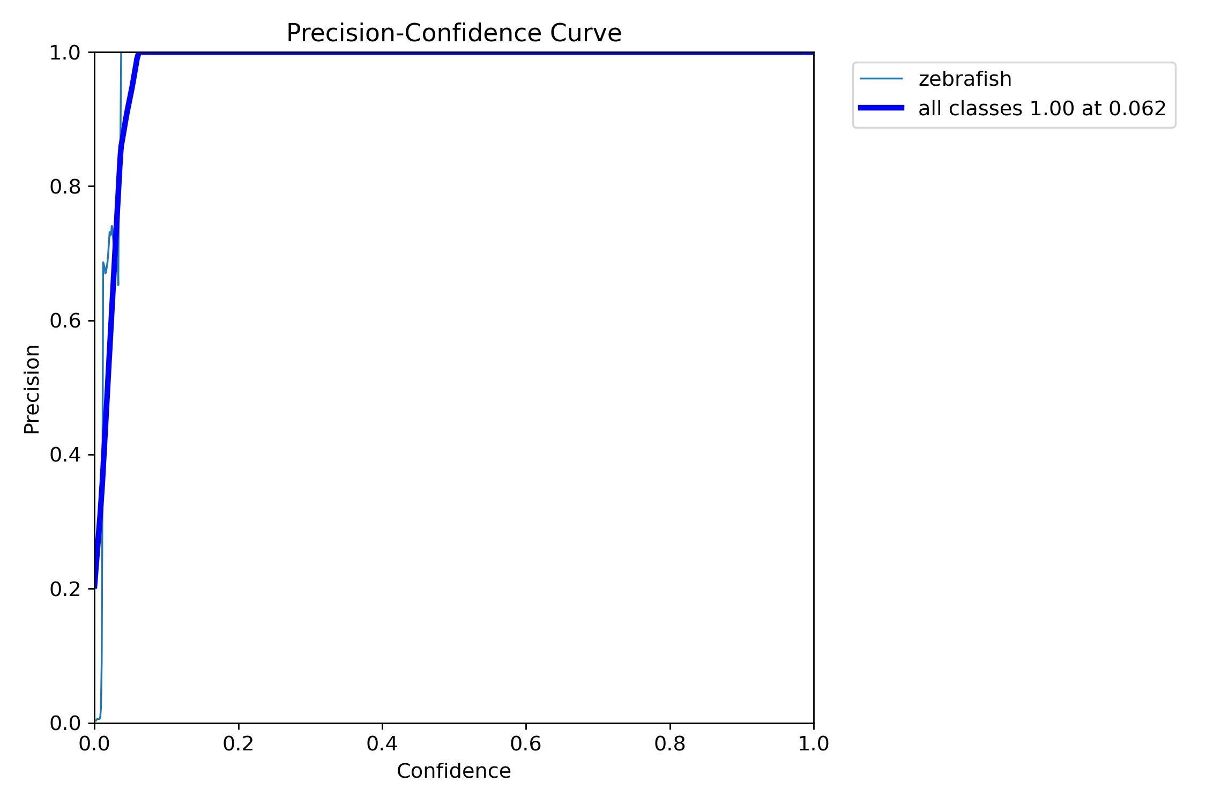

Slide 5
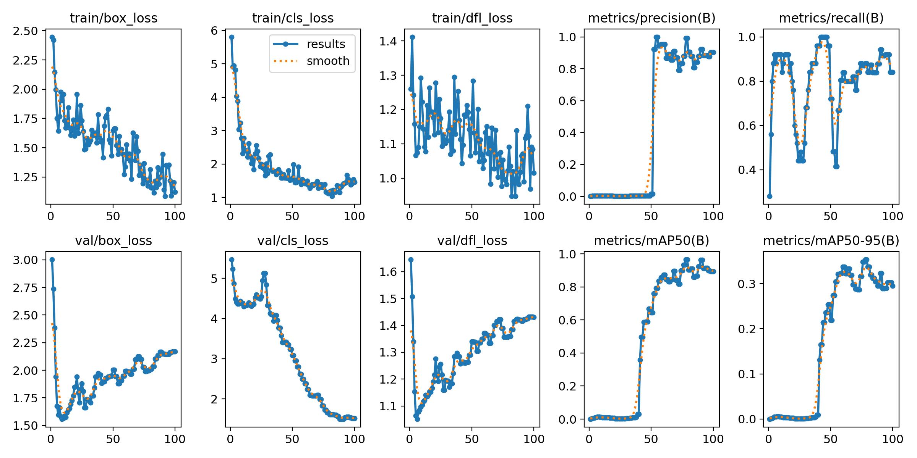
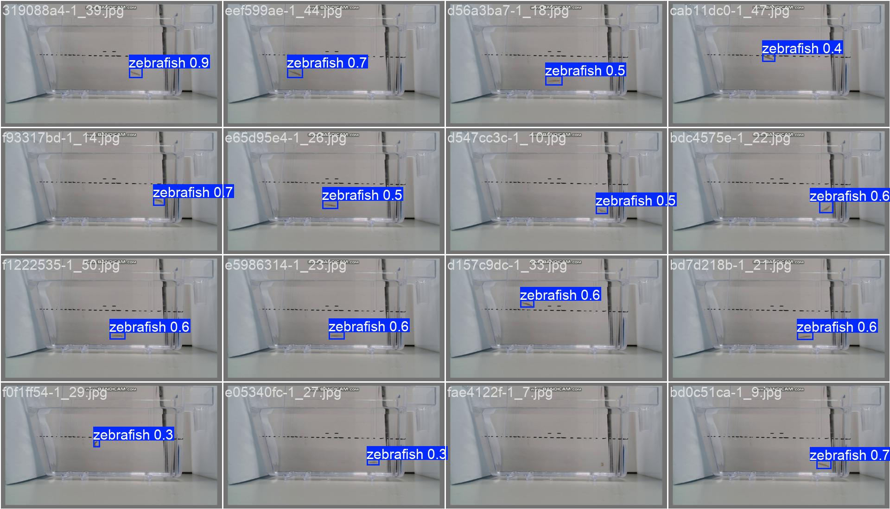
Mydataset 25pictures
Train 6
task: detect
mode: train
model: yolo11n.yaml
data: D:/Test_File/Code/Zebrafish-NTT-AI-Model/mydataset.yaml
epochs: 100
time: null
patience: 100
batch: 16
imgsz: 640

Slide 6
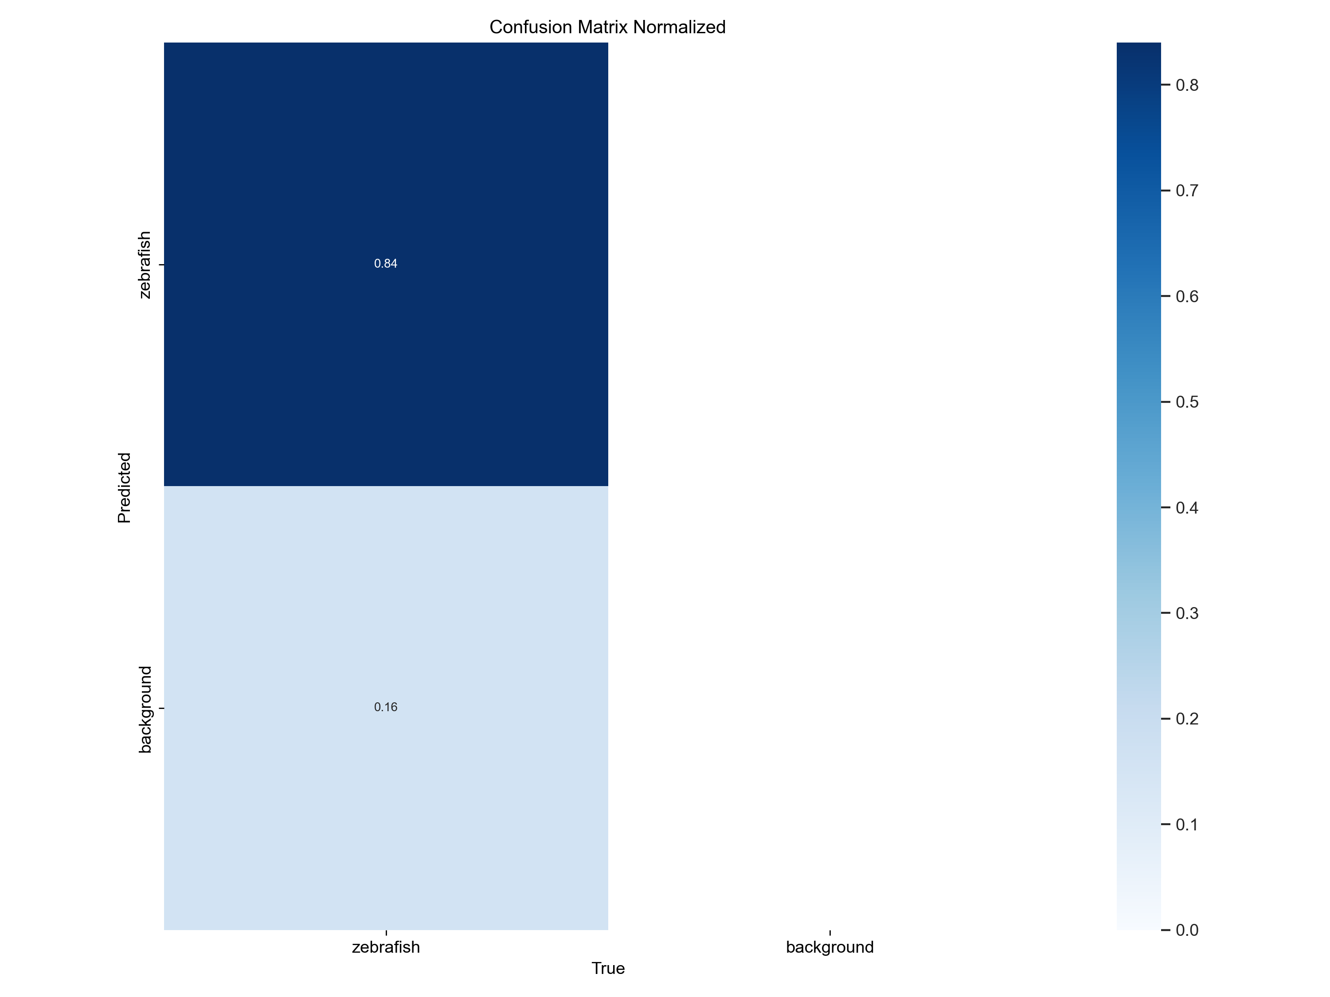

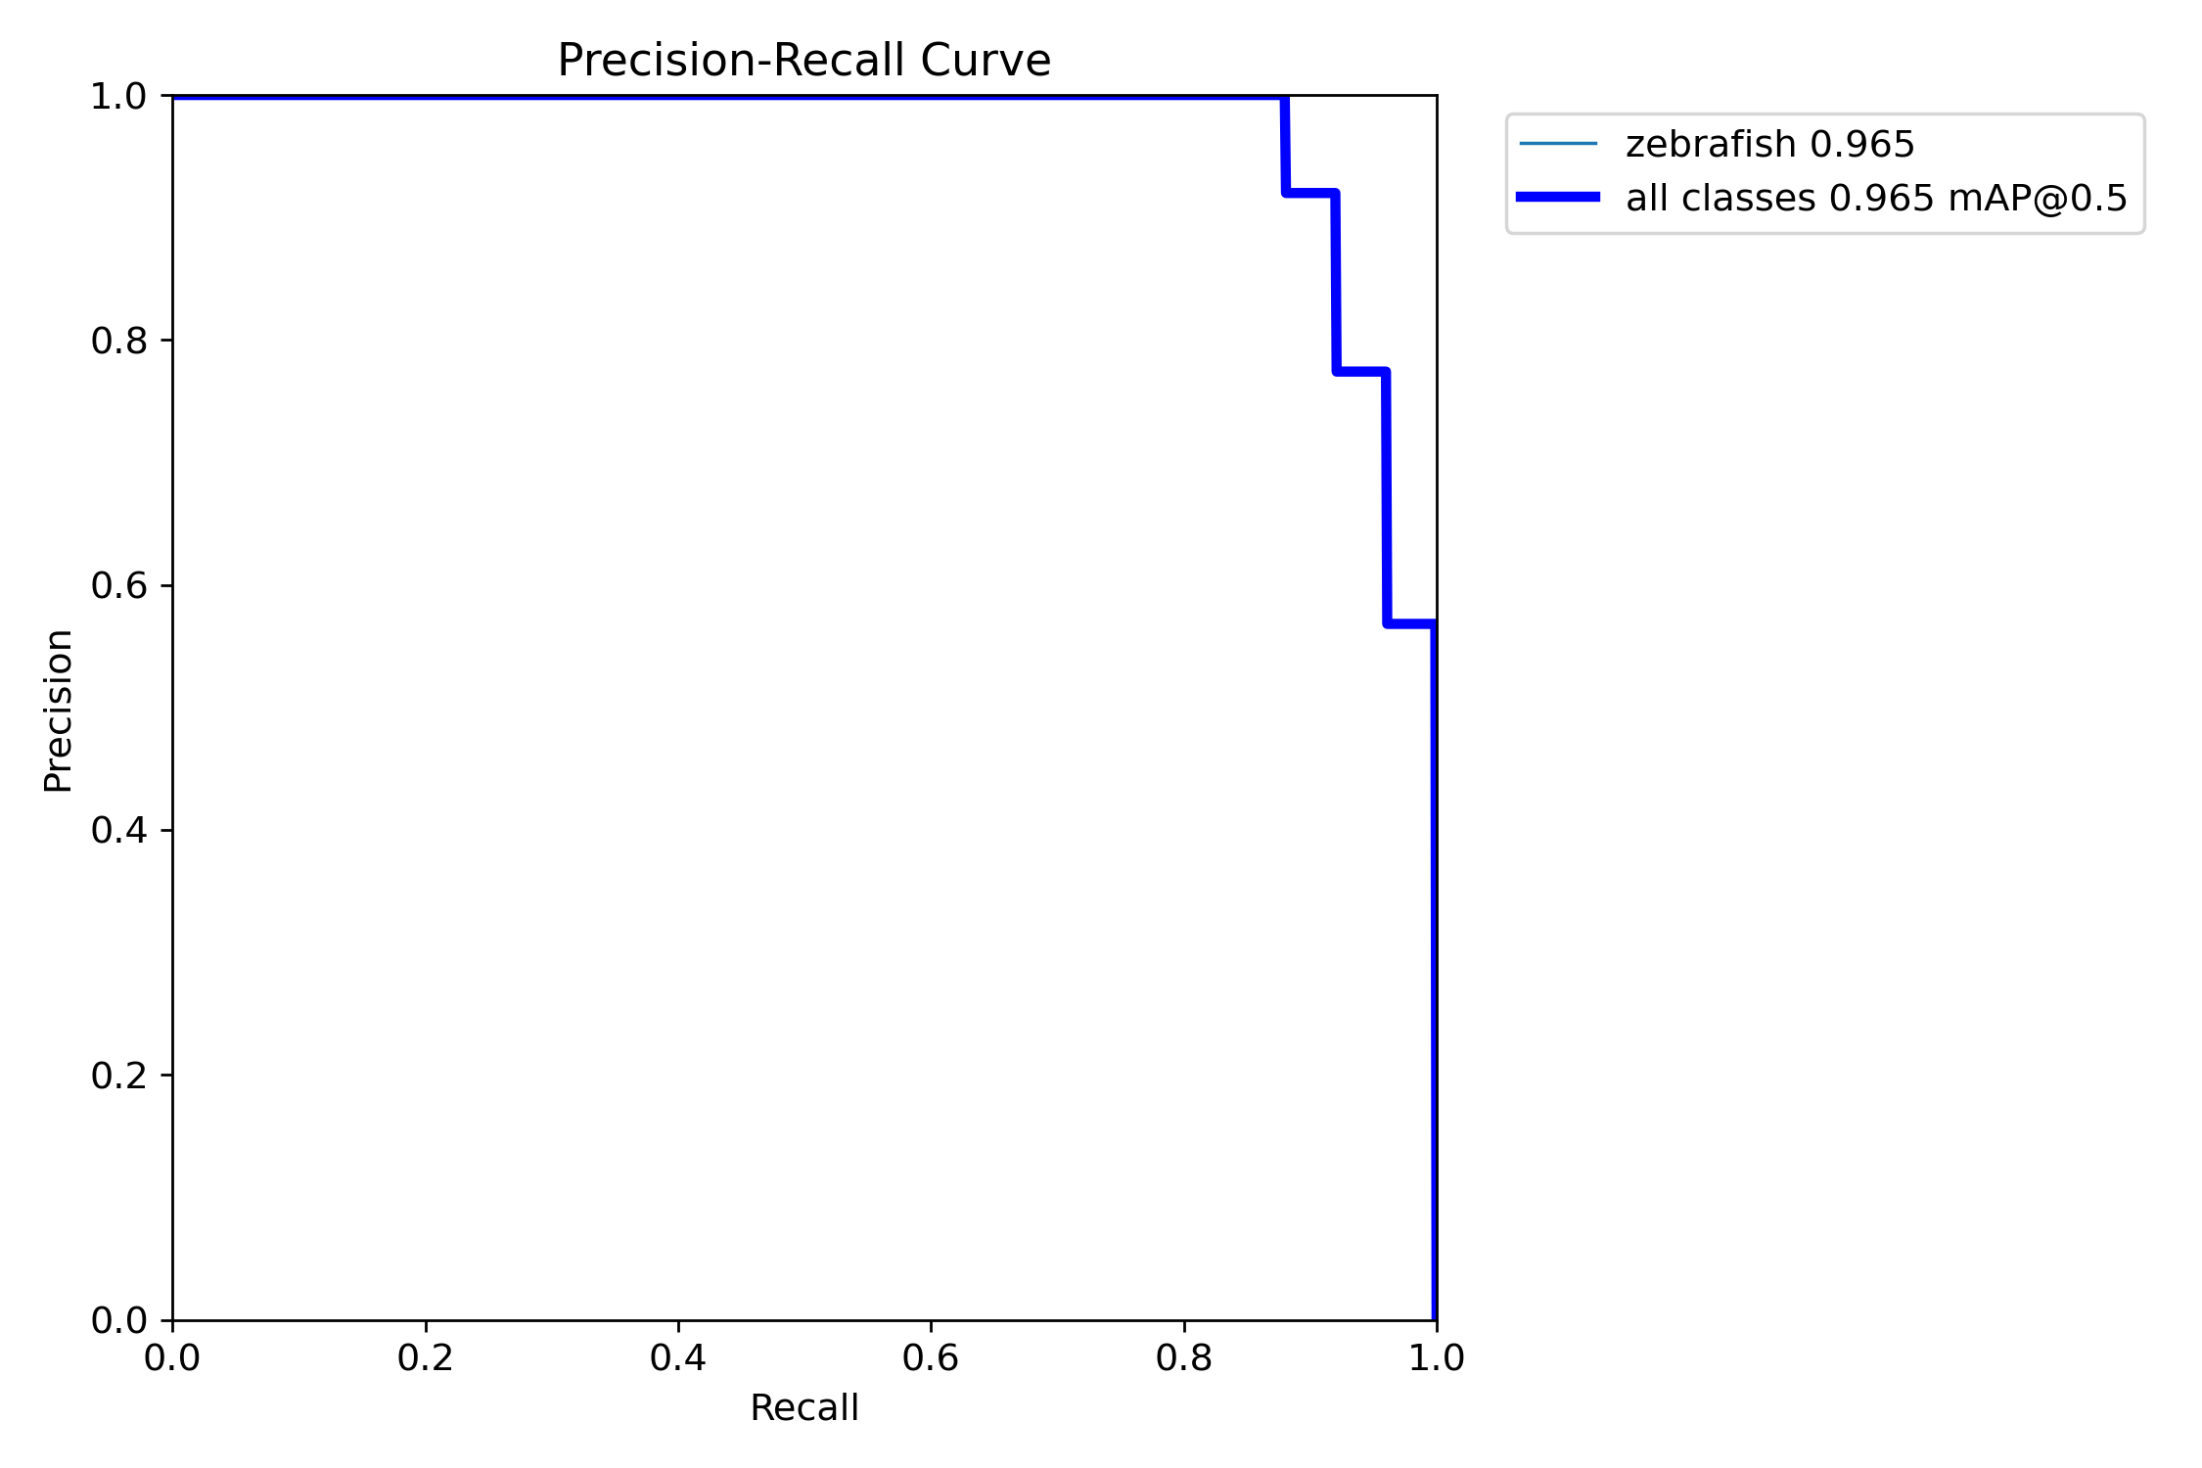
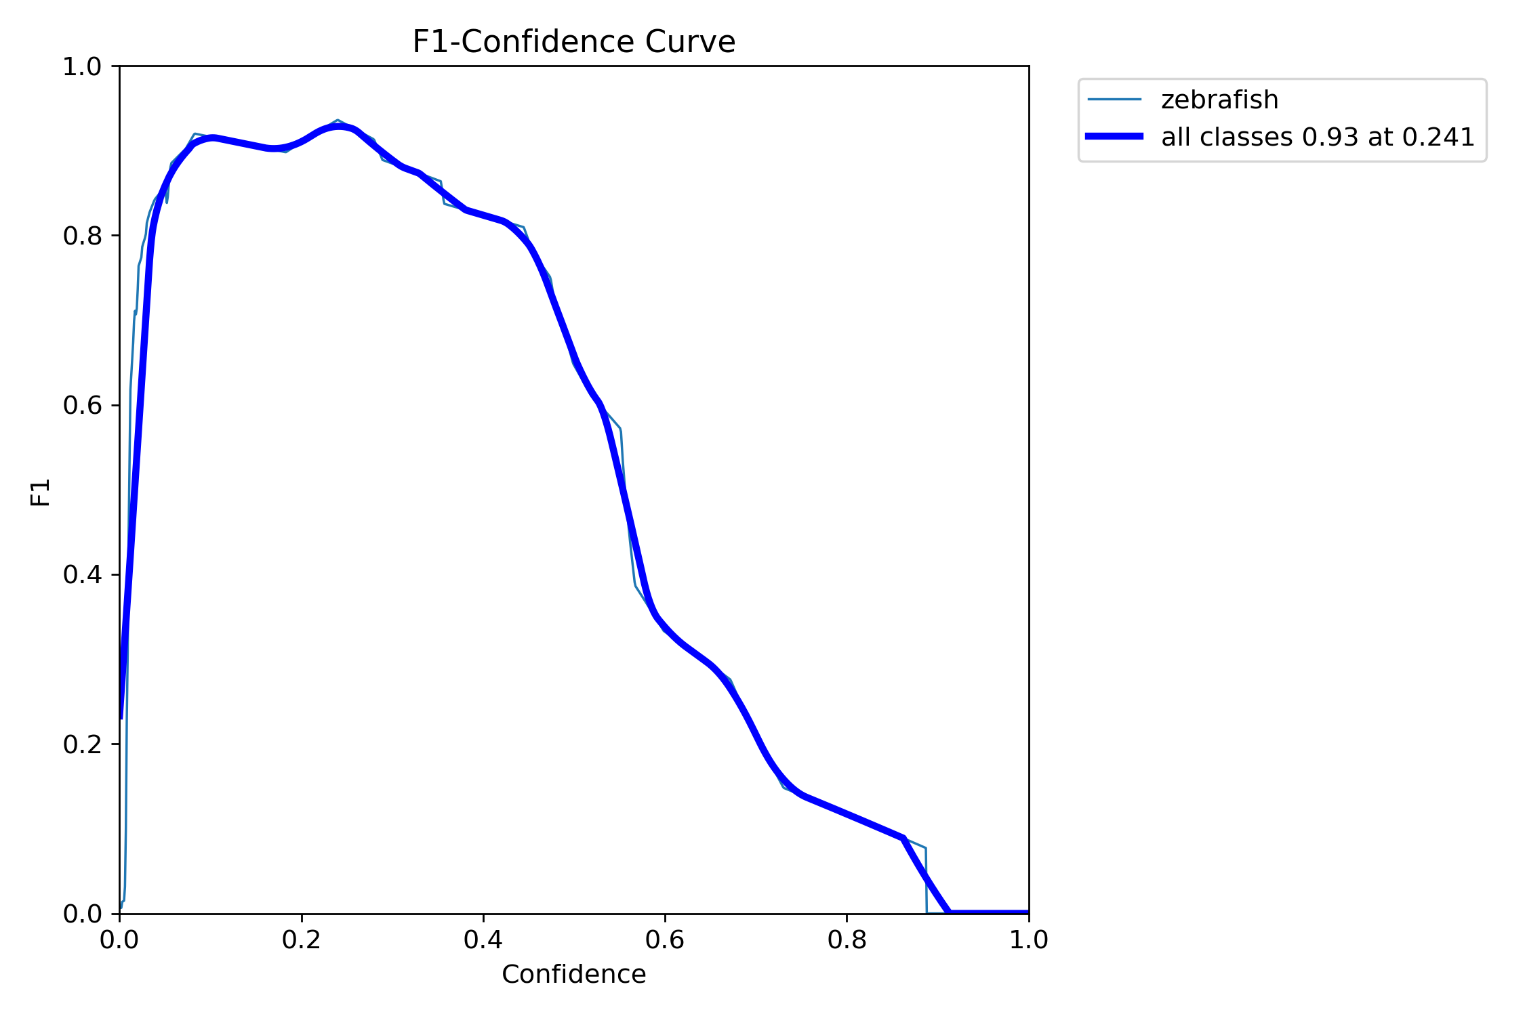
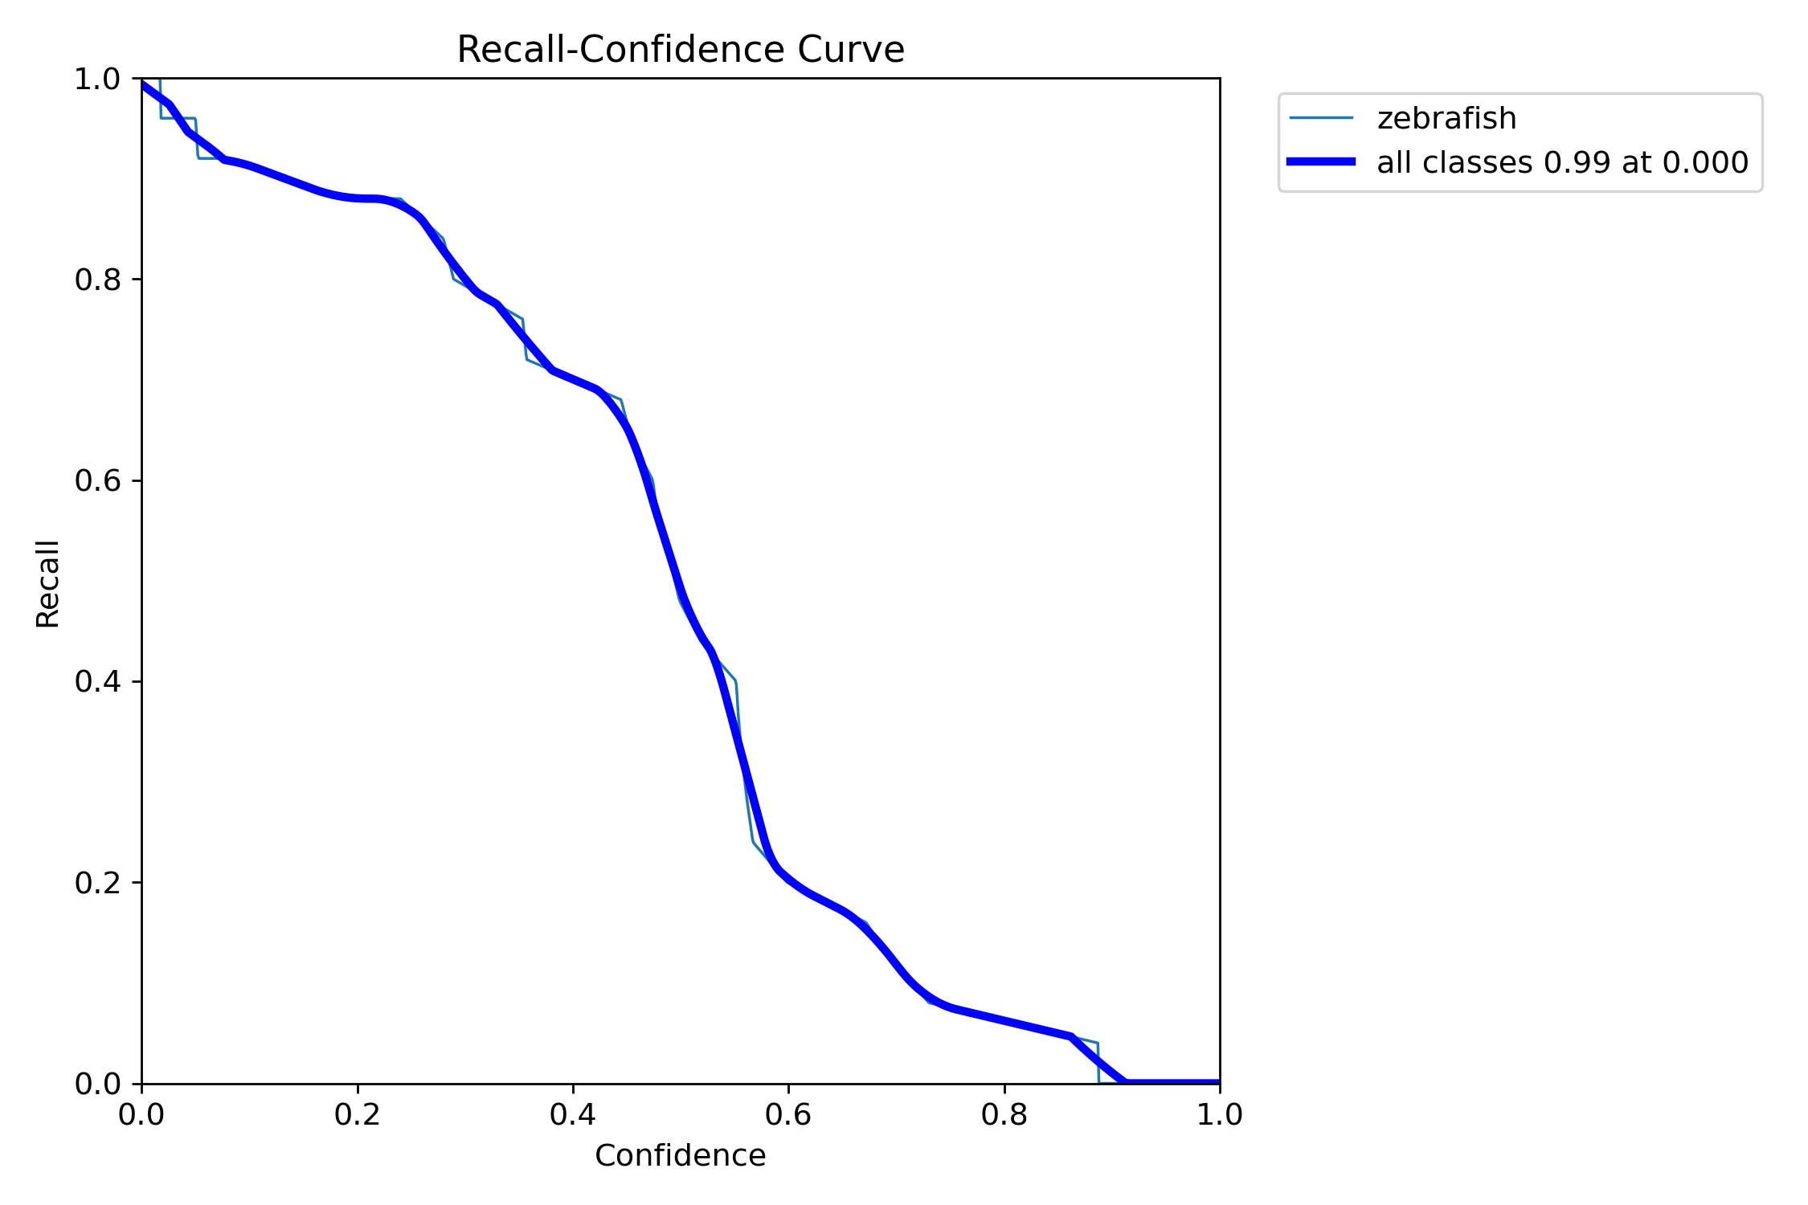
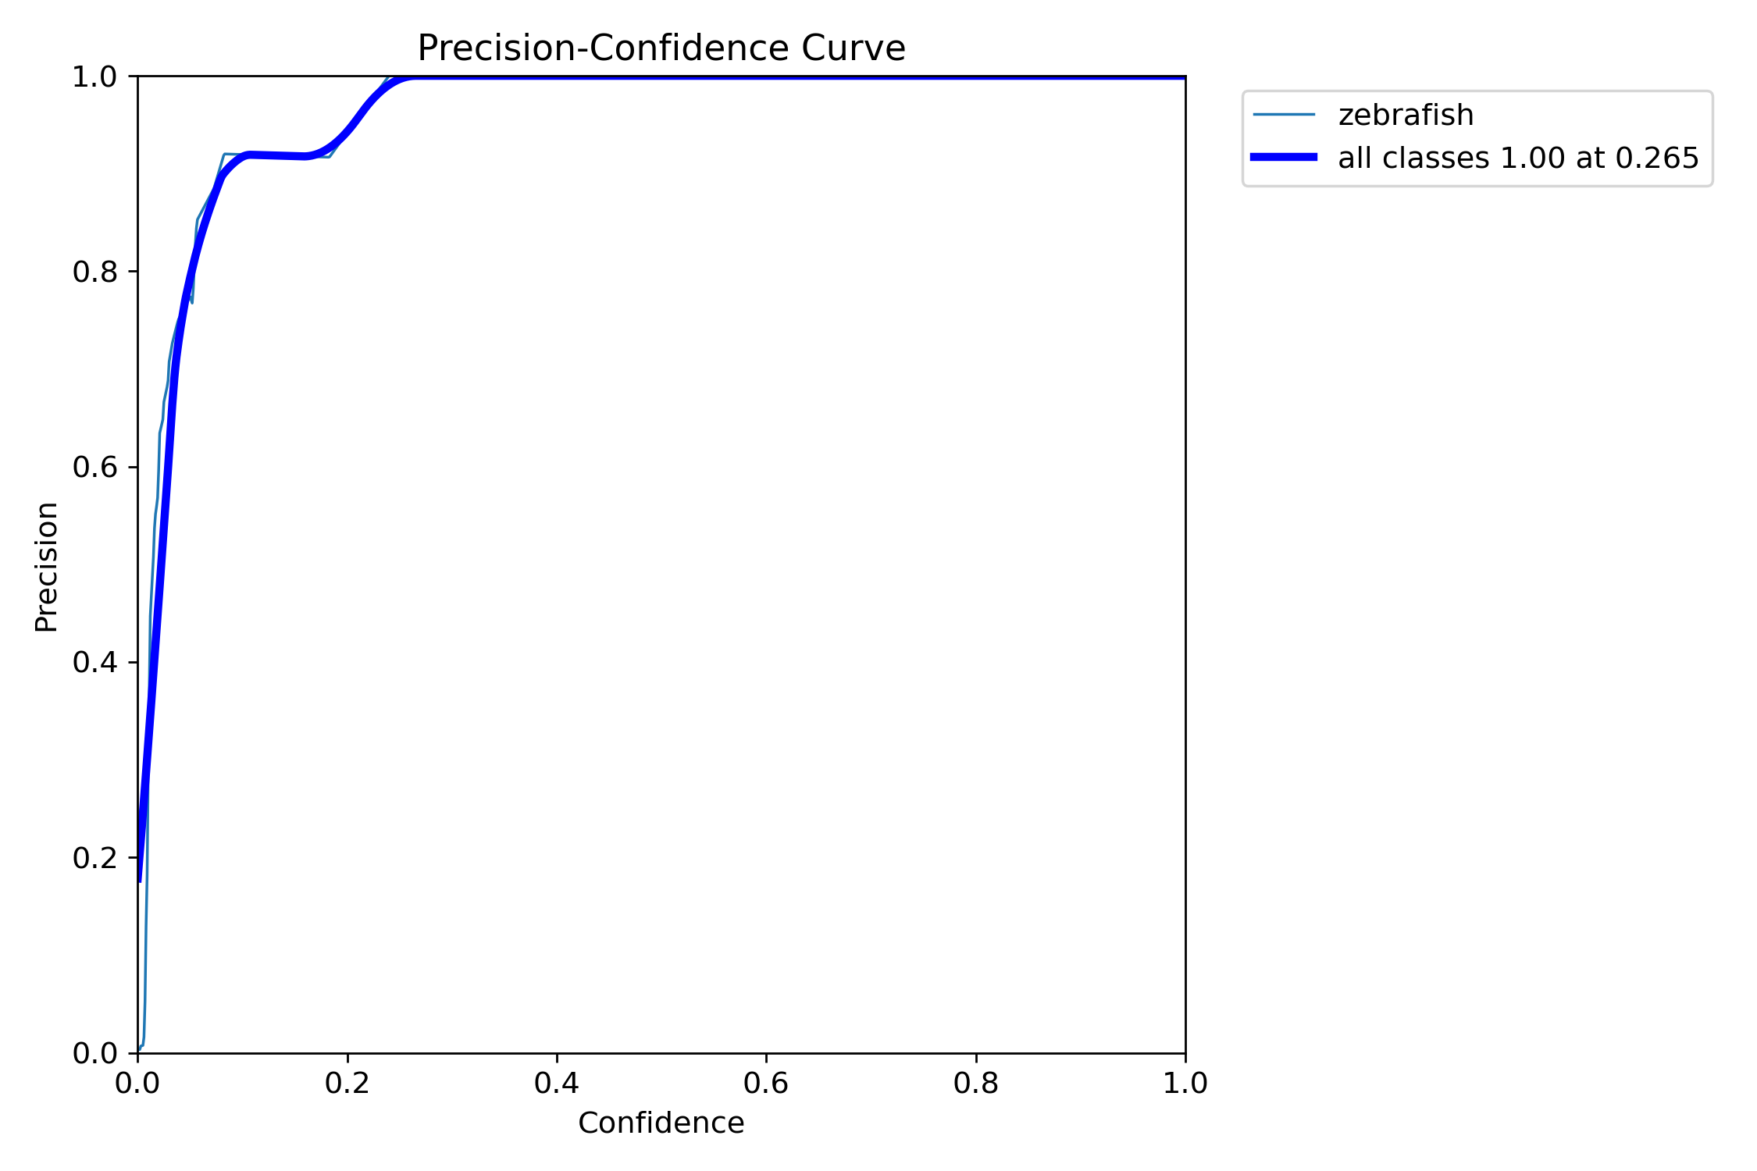

Slide 7
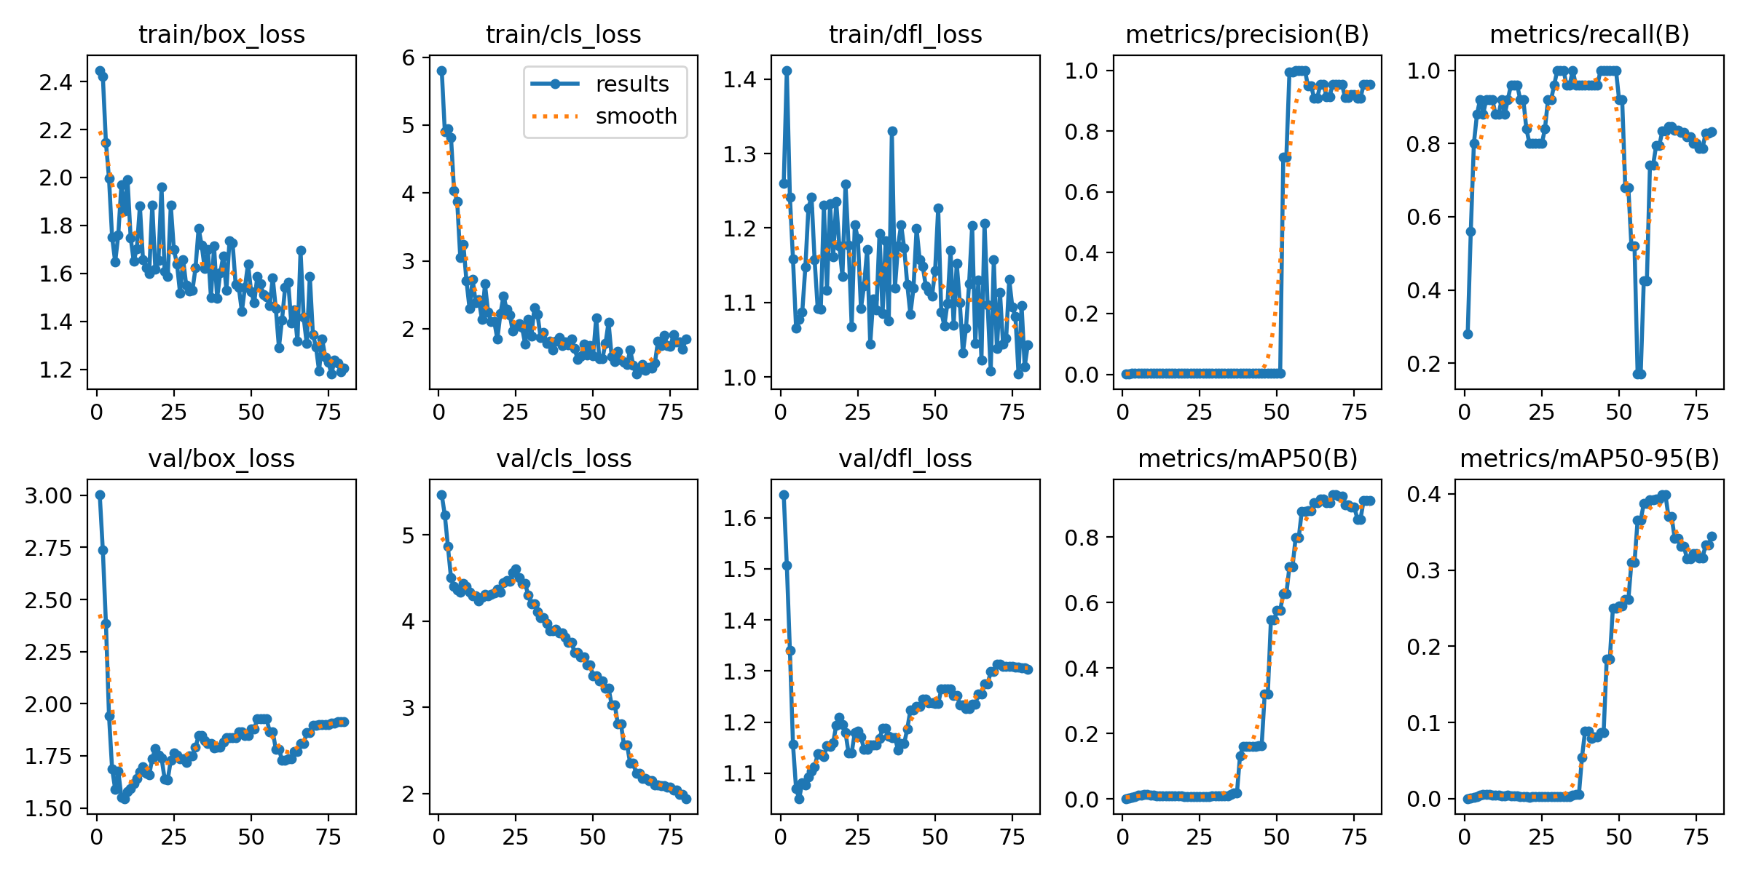
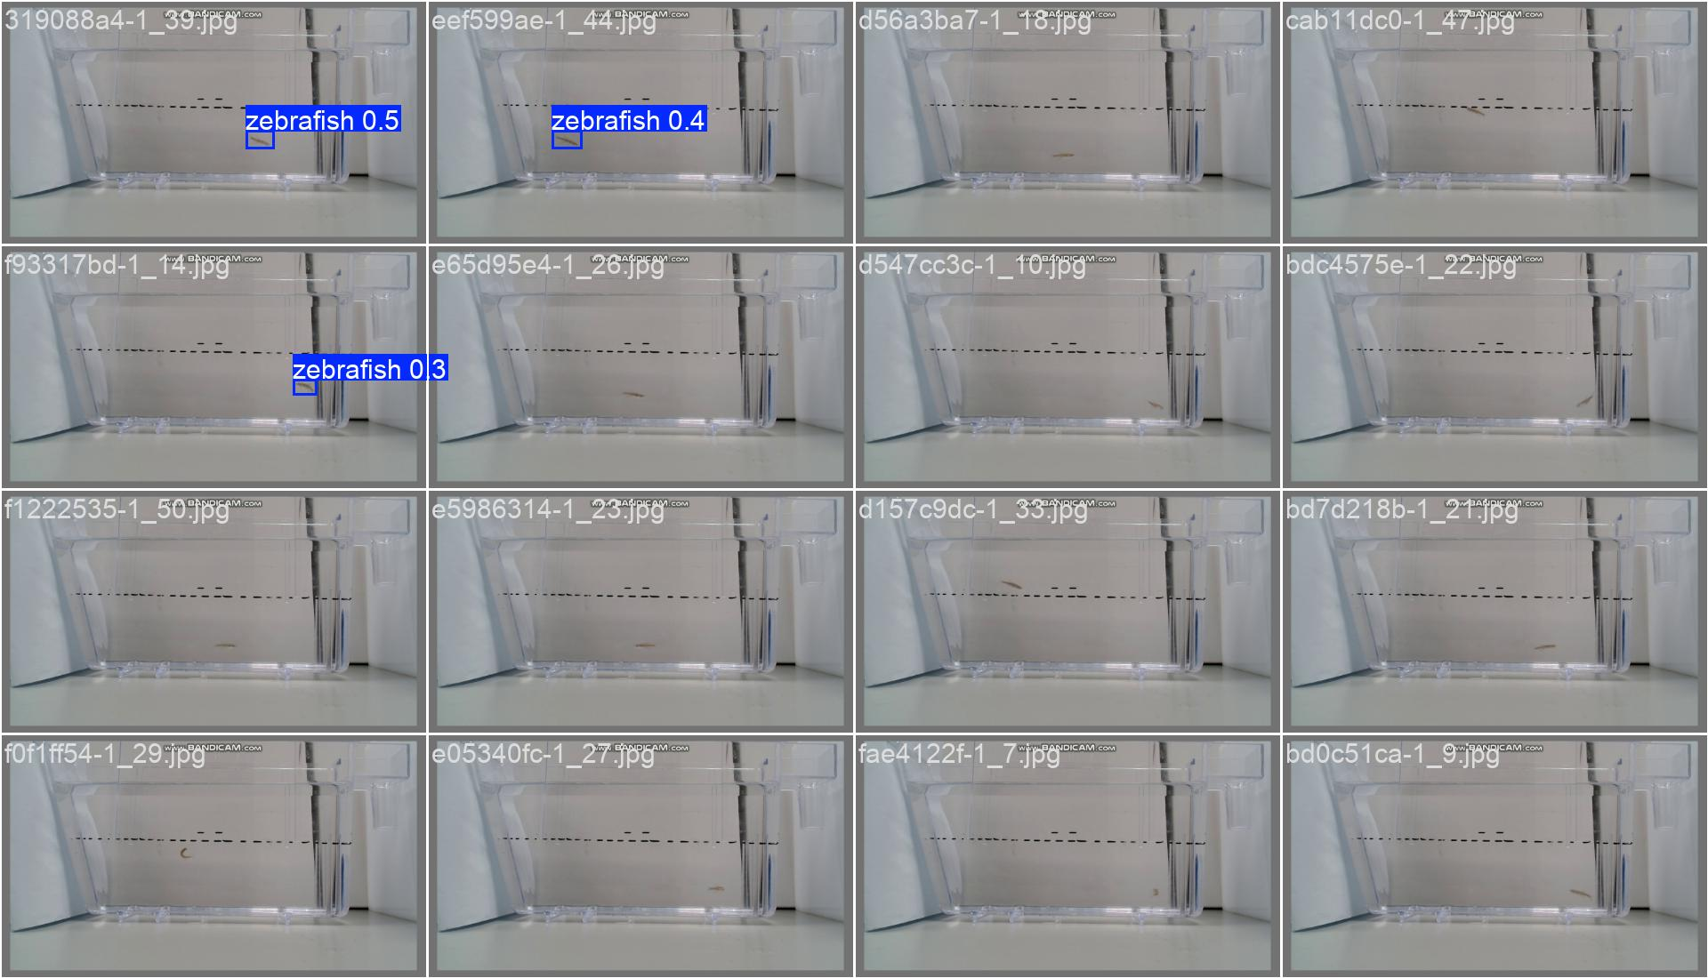
Mydataset 25pictures
Train 11
task: detect
mode: train
model: yolo11n.yaml
data: D:/Test_File/Code/Zebrafish-NTT-AI-Model/mydataset.yaml
epochs: 80
time: null
patience: 100
batch: 16
imgsz: 640

Slide 8
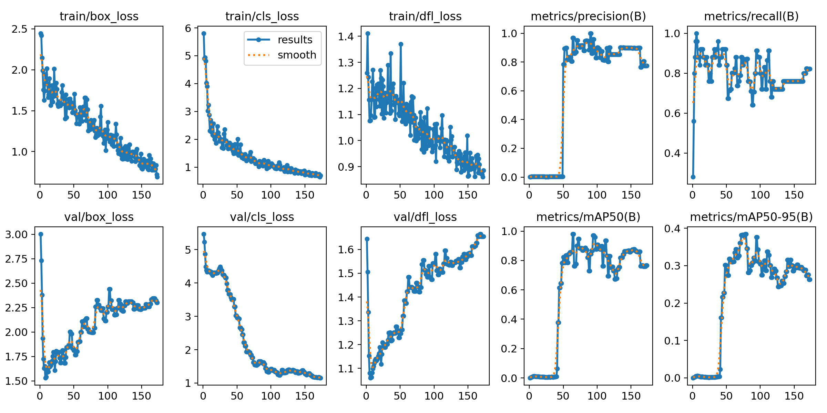
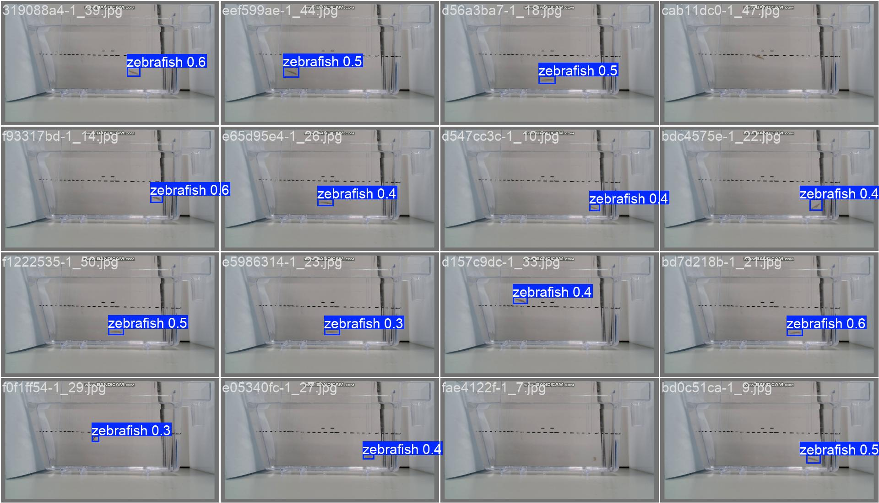
Mydataset 25pictures
Train 13
task: detect
mode: train
model: yolo11n.yaml
data: D:/Test_File/Code/Zebrafish-NTT-AI-Model/mydataset.yaml
epochs: 200
time: null
patience: 100
batch: 16
imgsz: 640

Slide 9
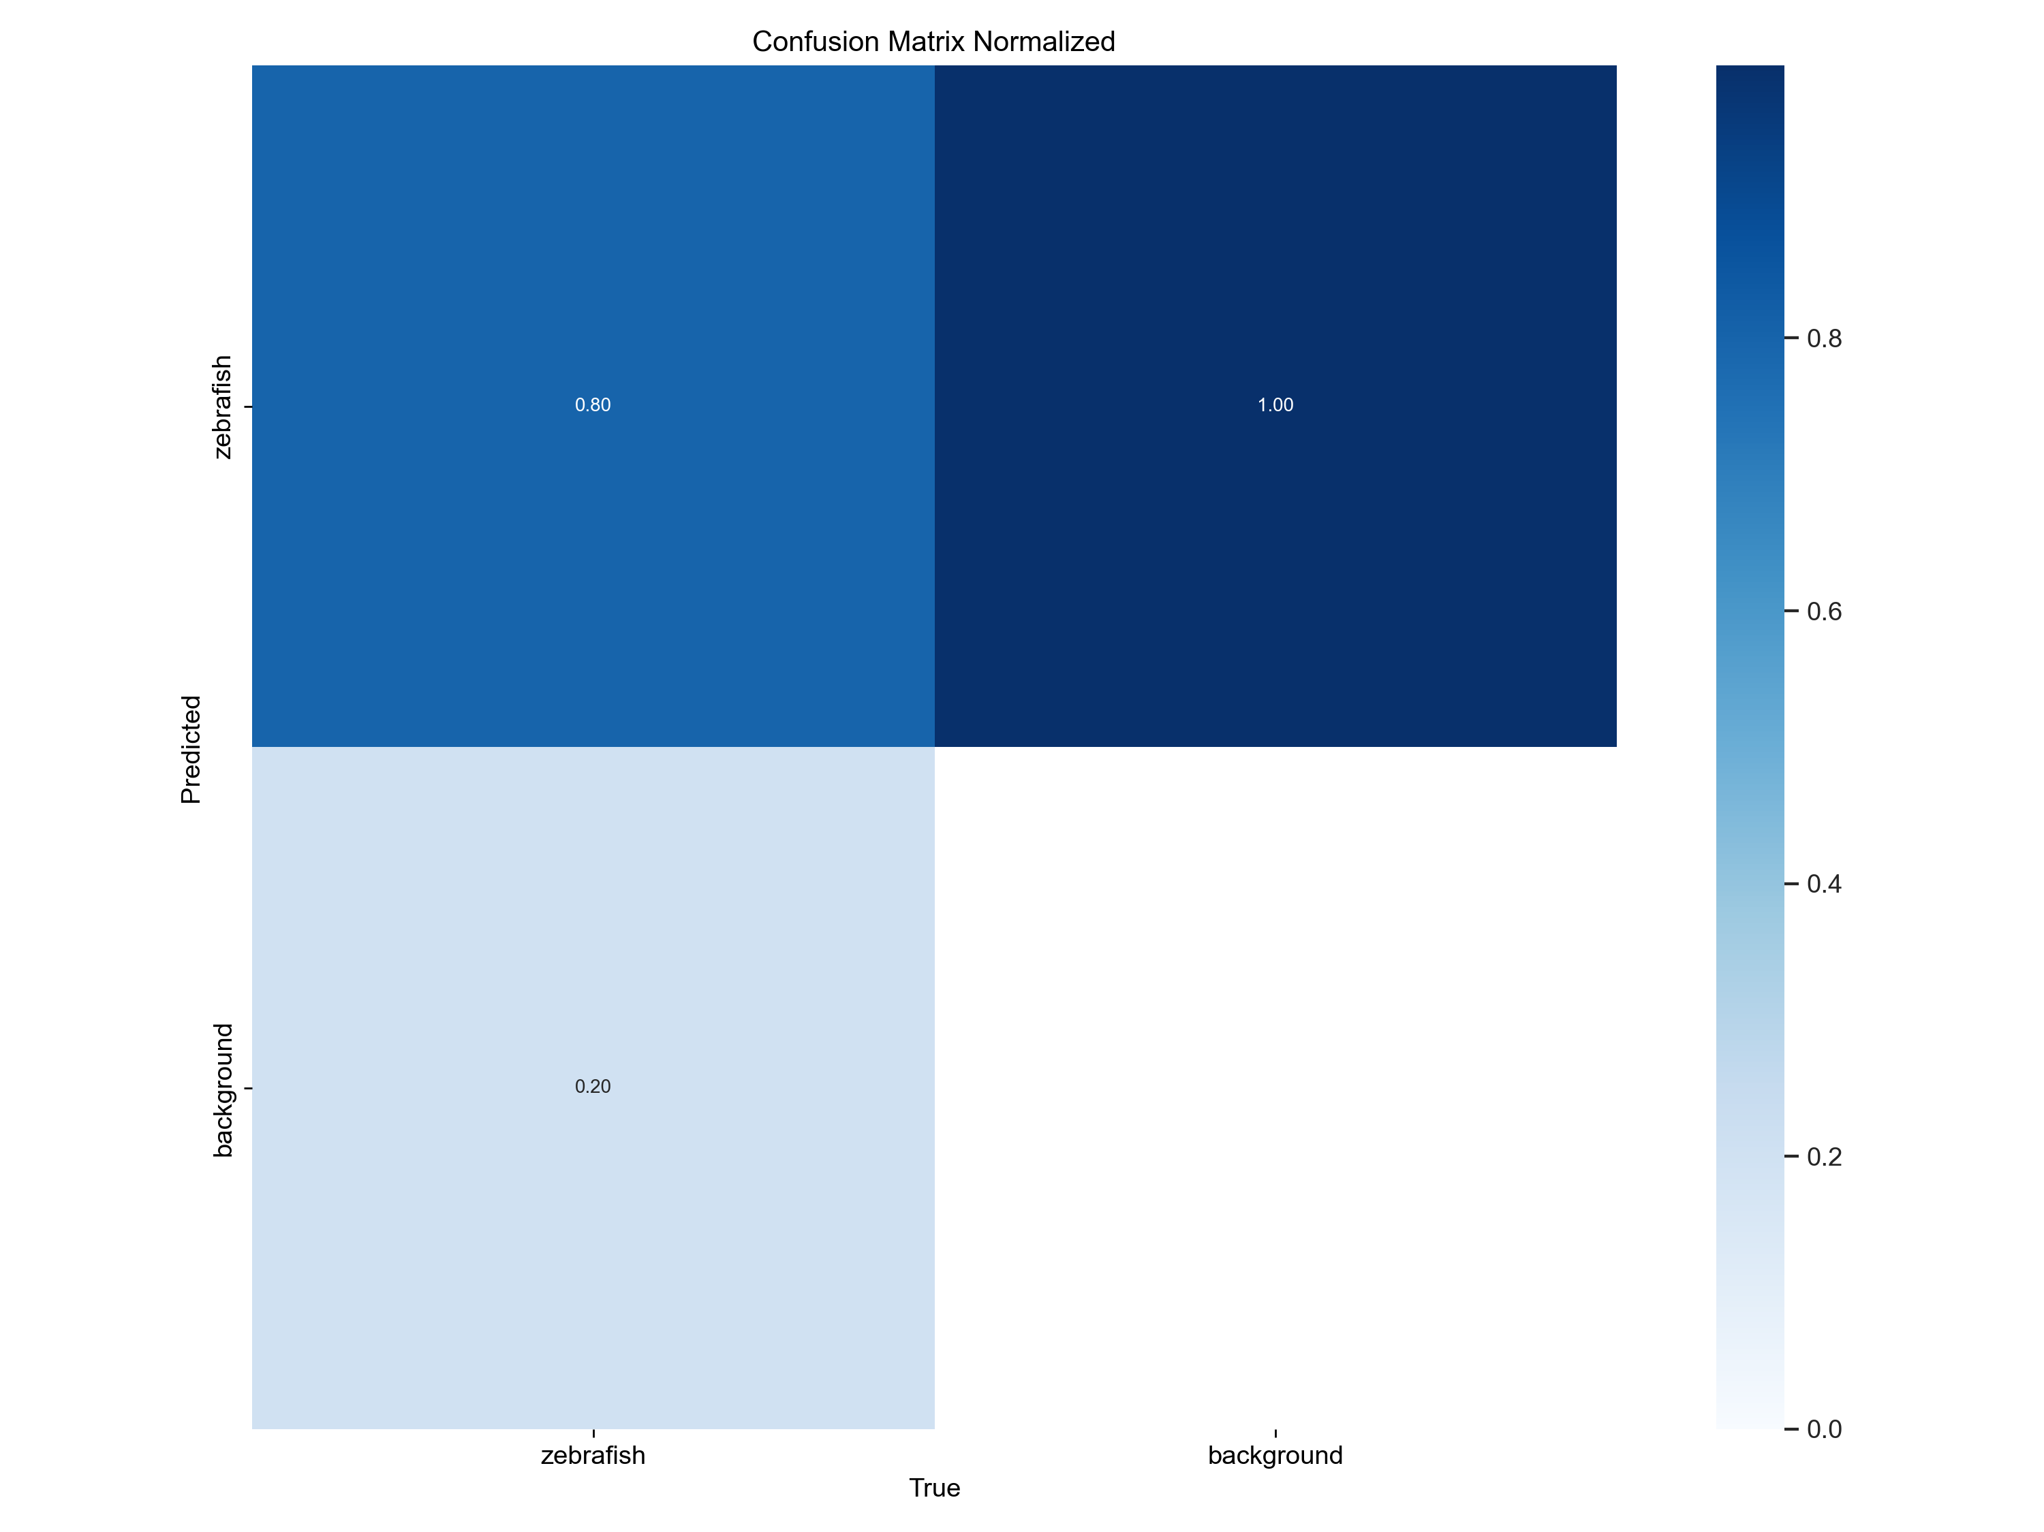
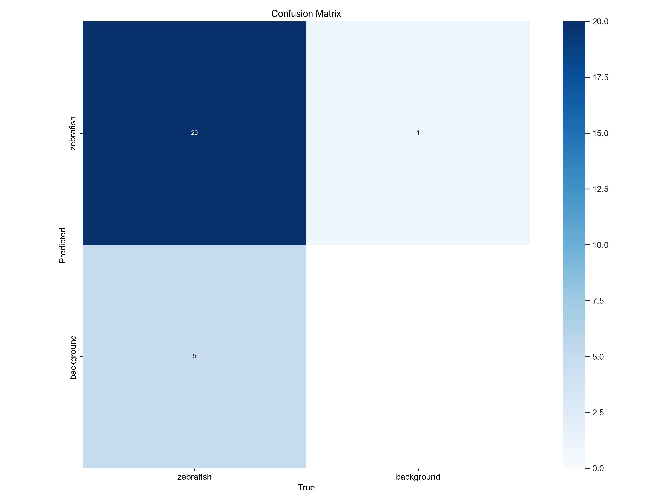
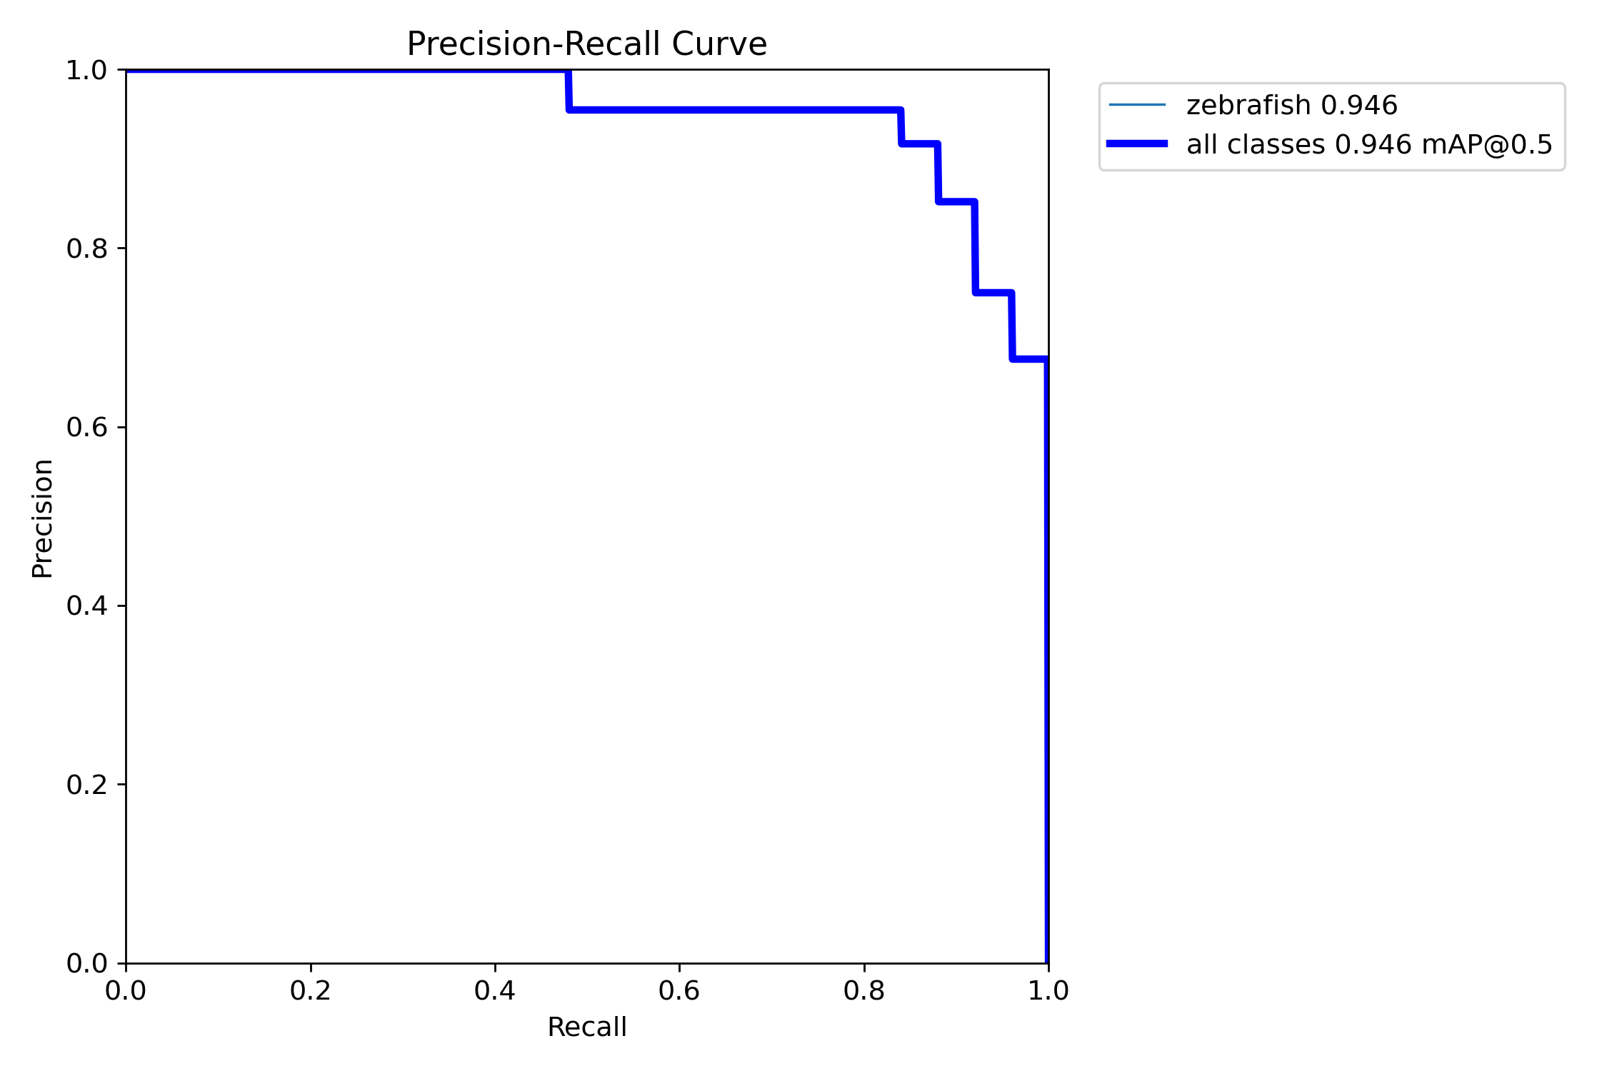
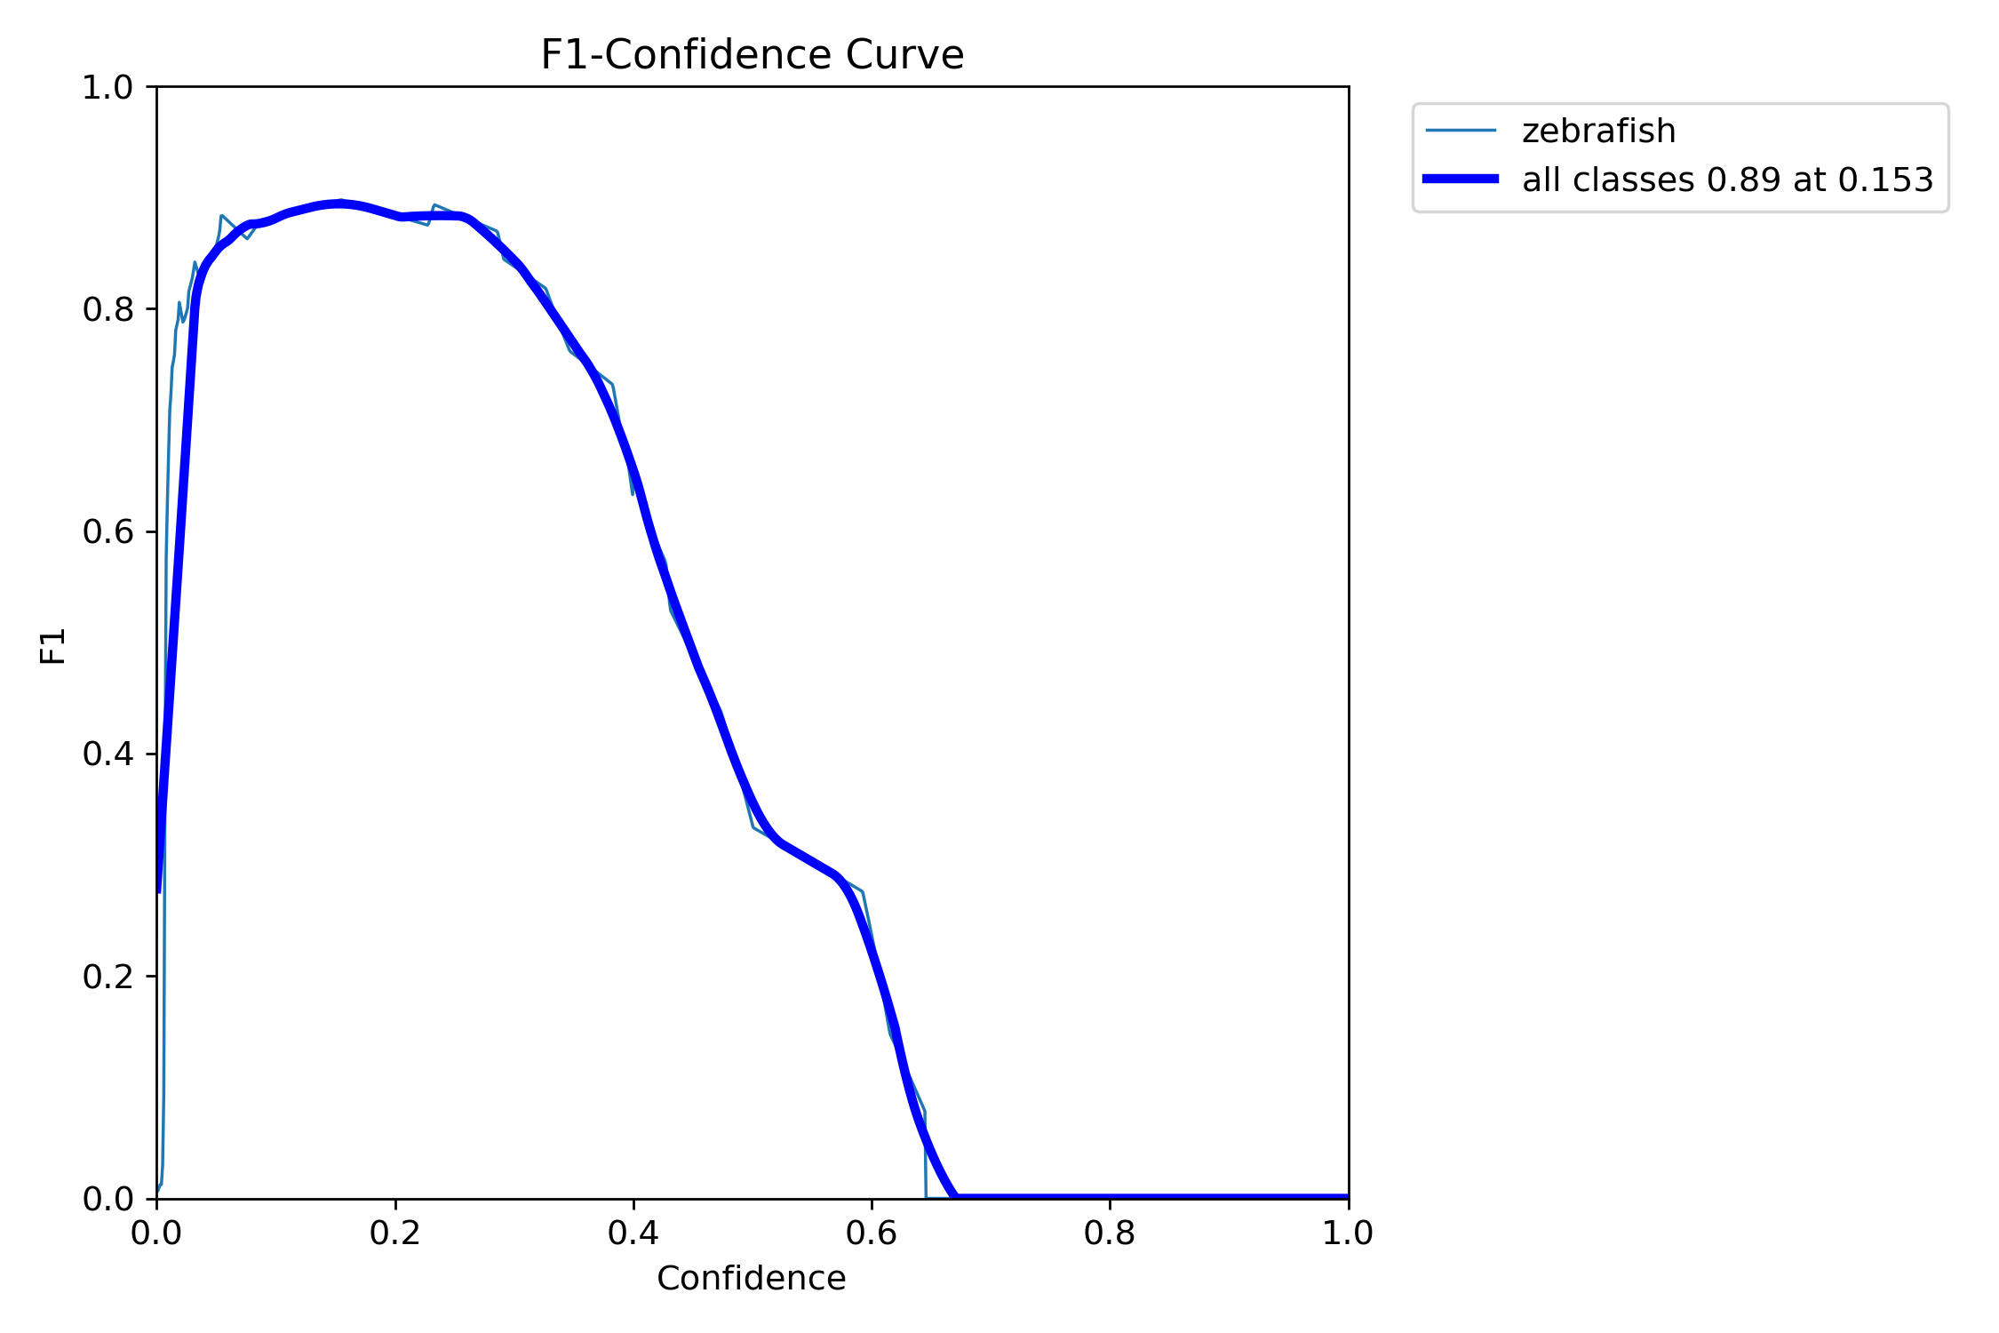
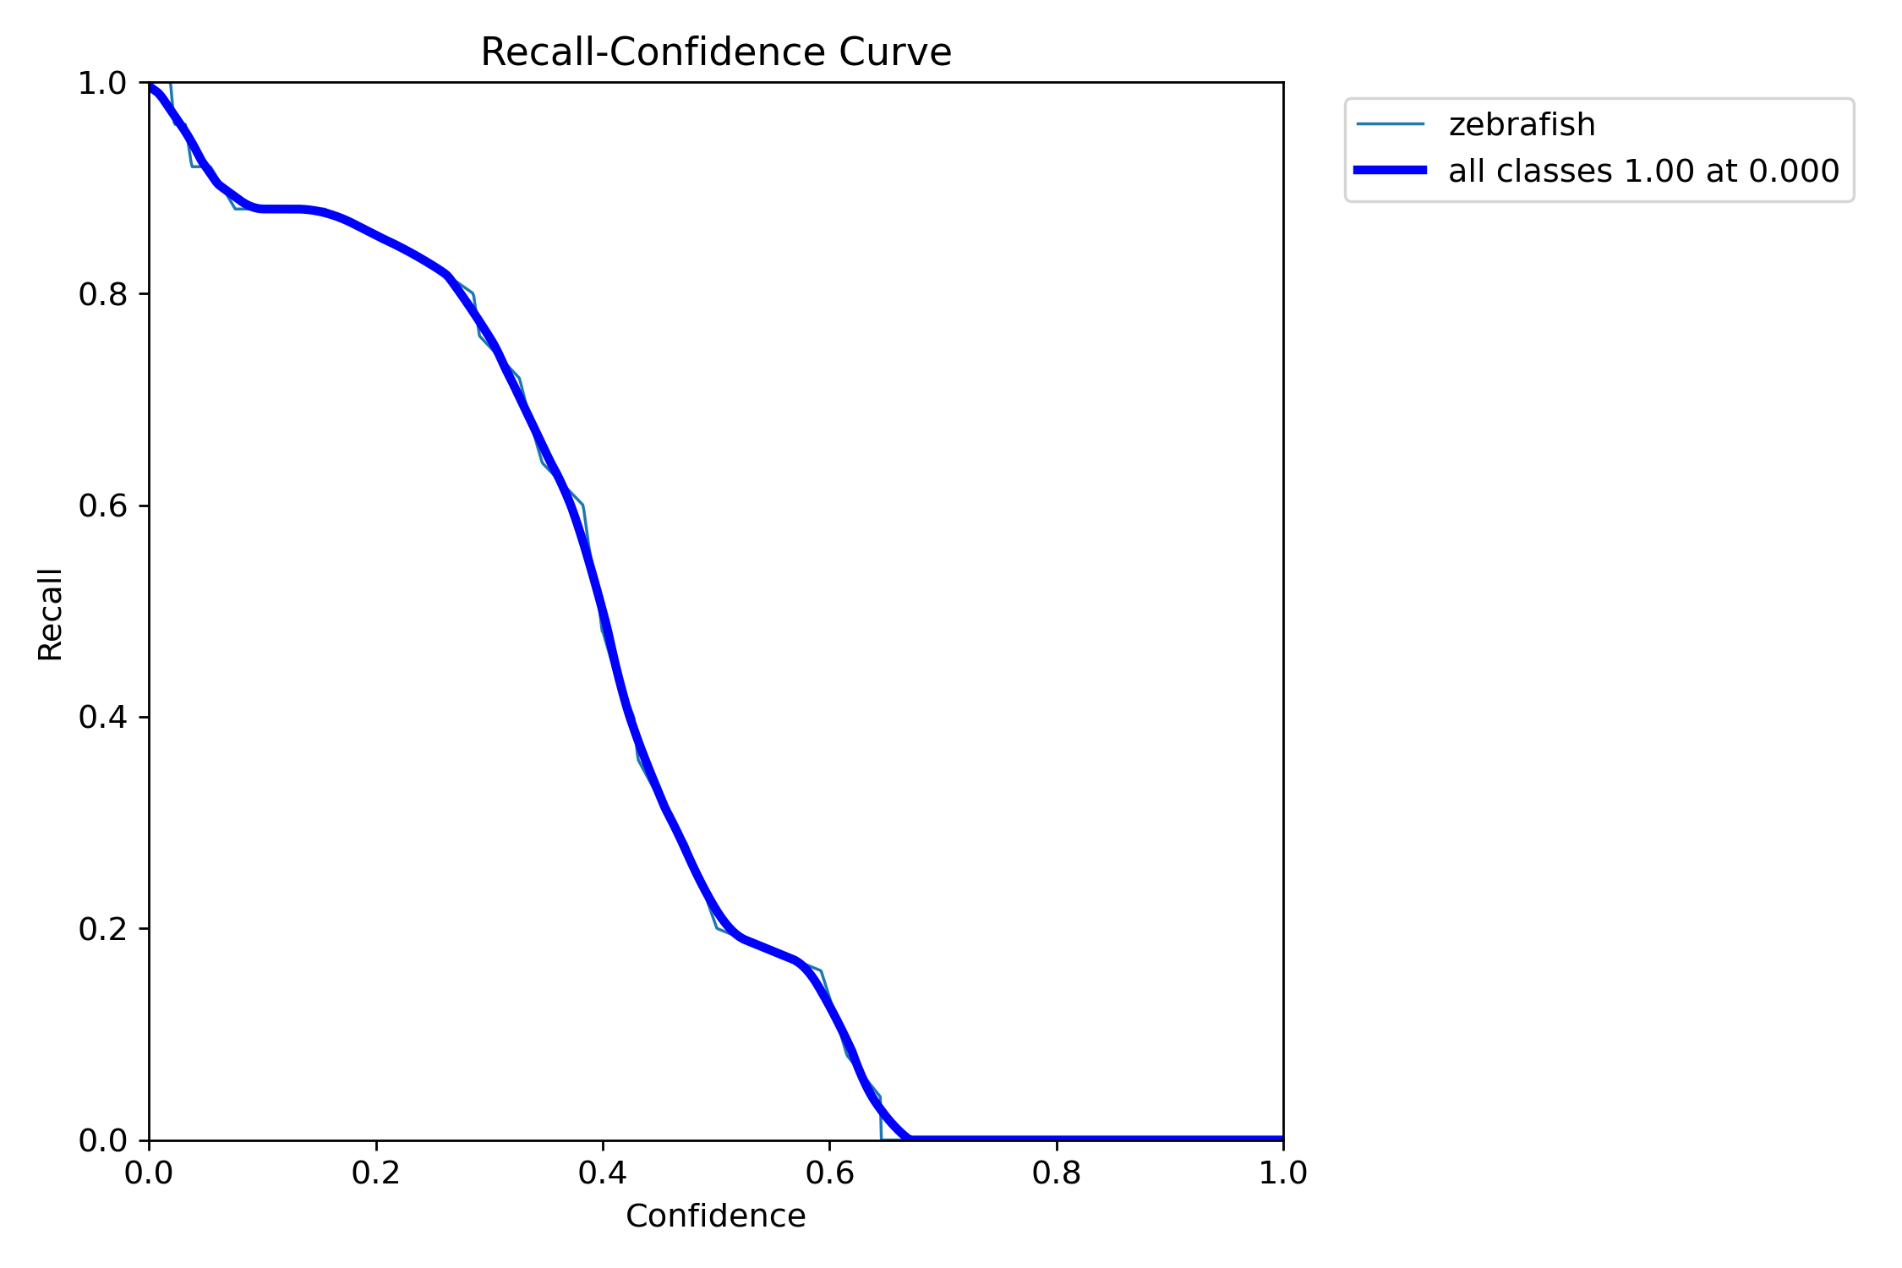
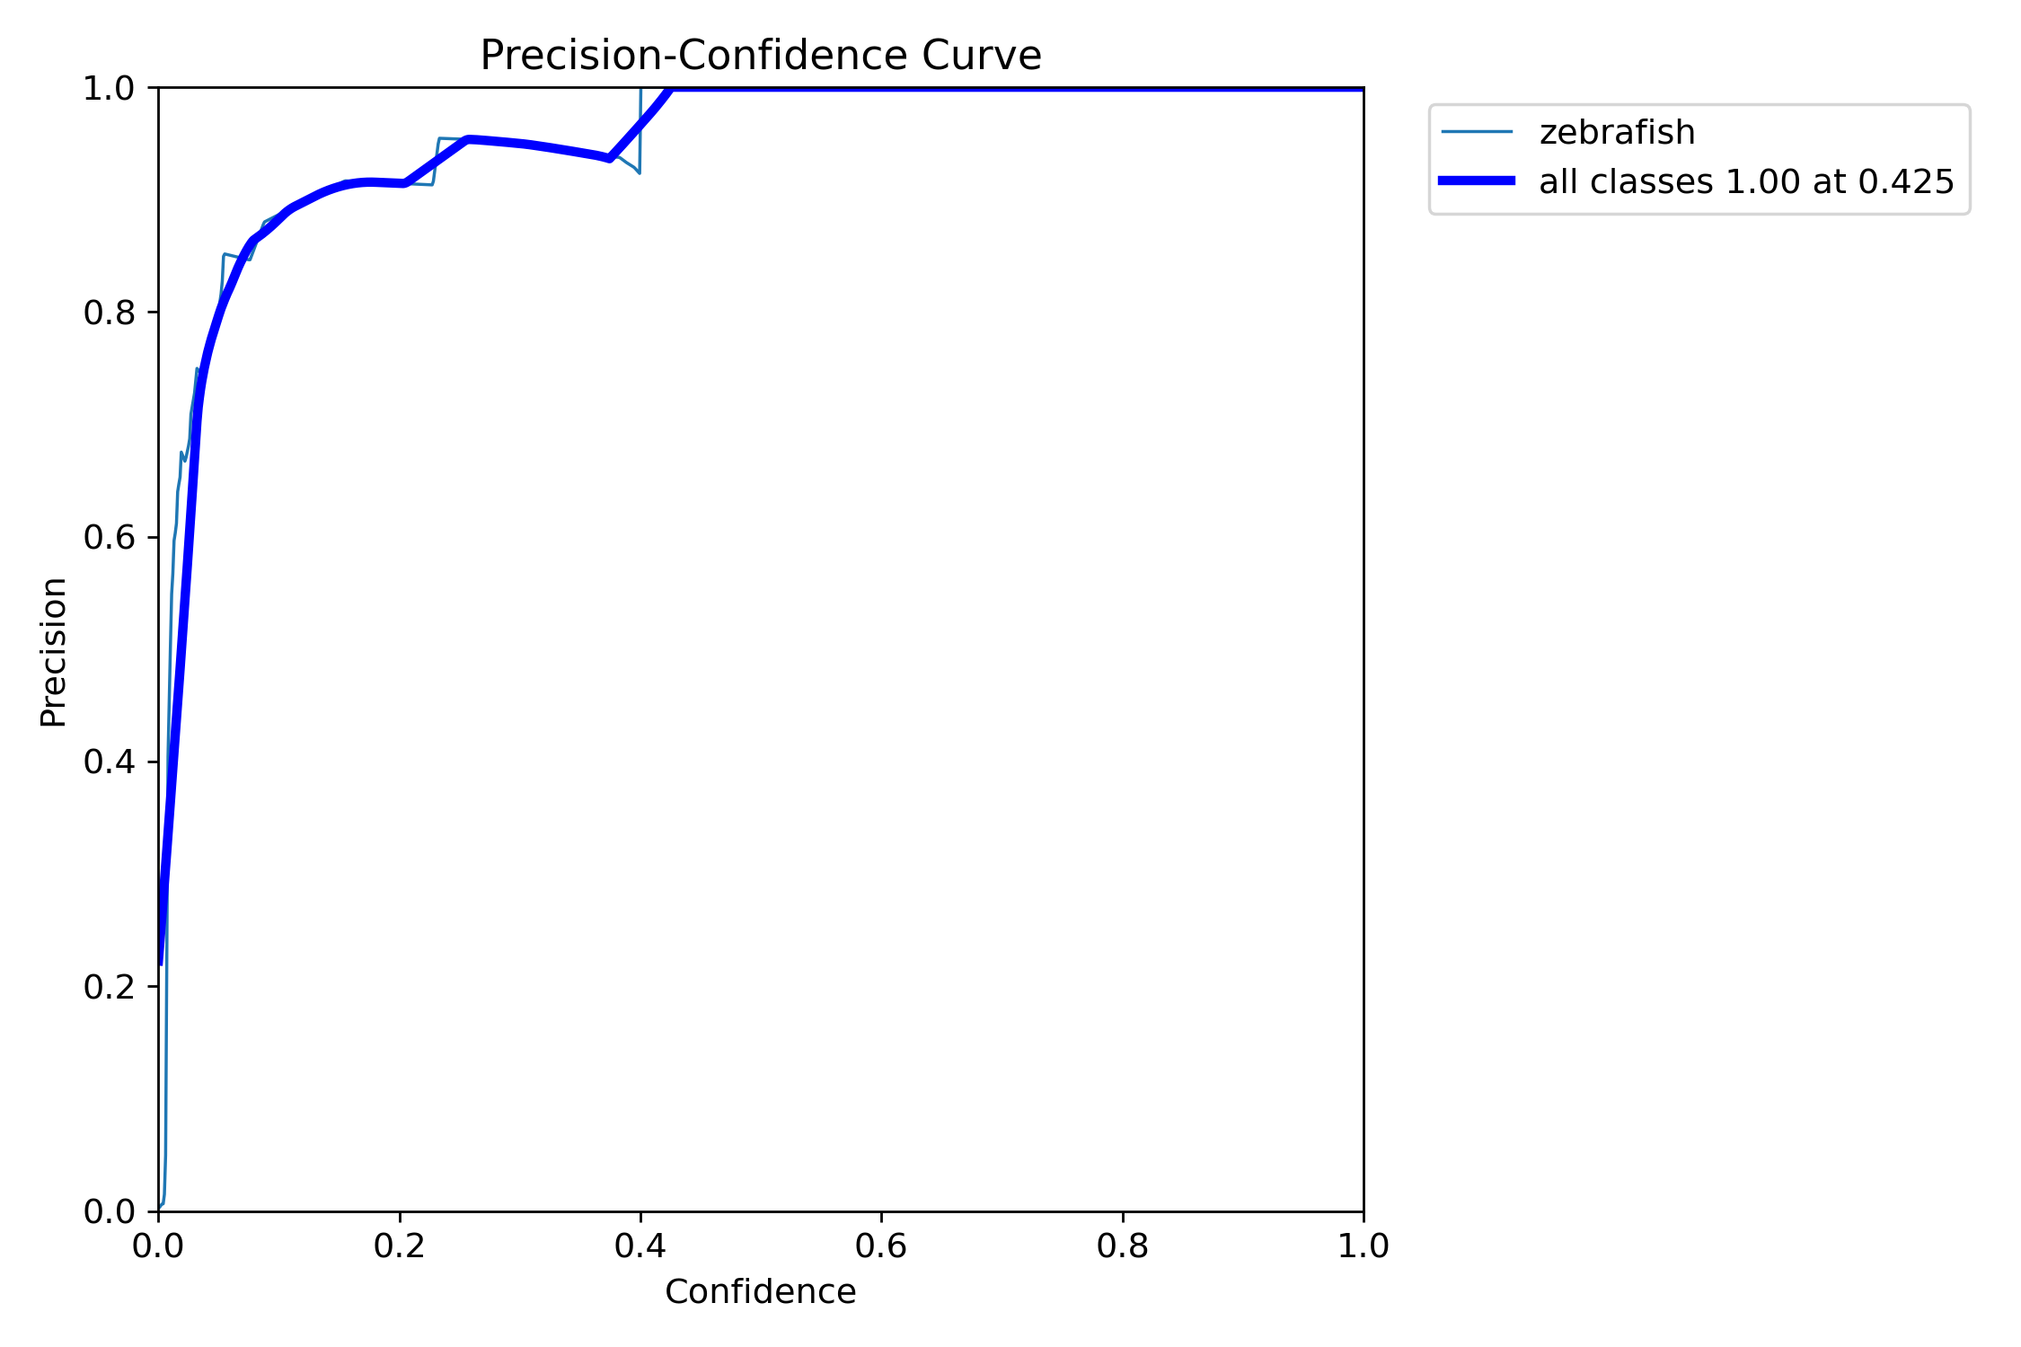

Slide 10
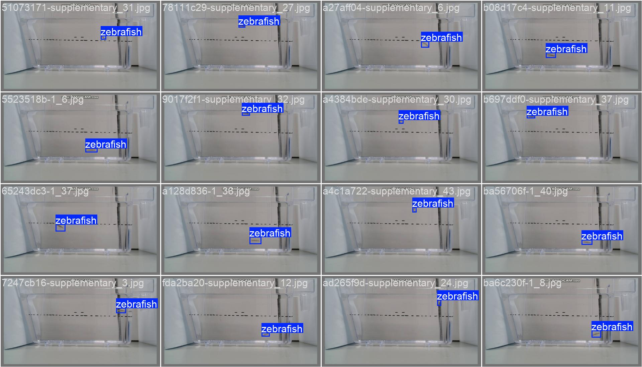
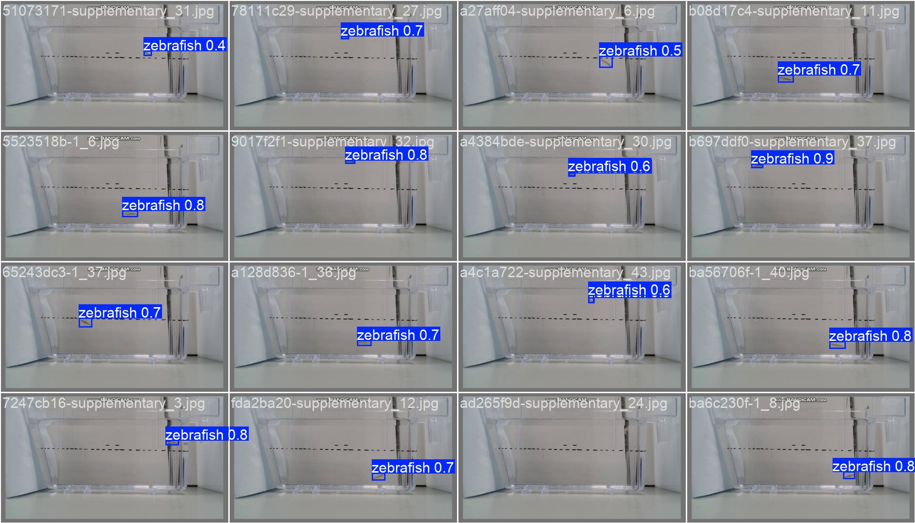
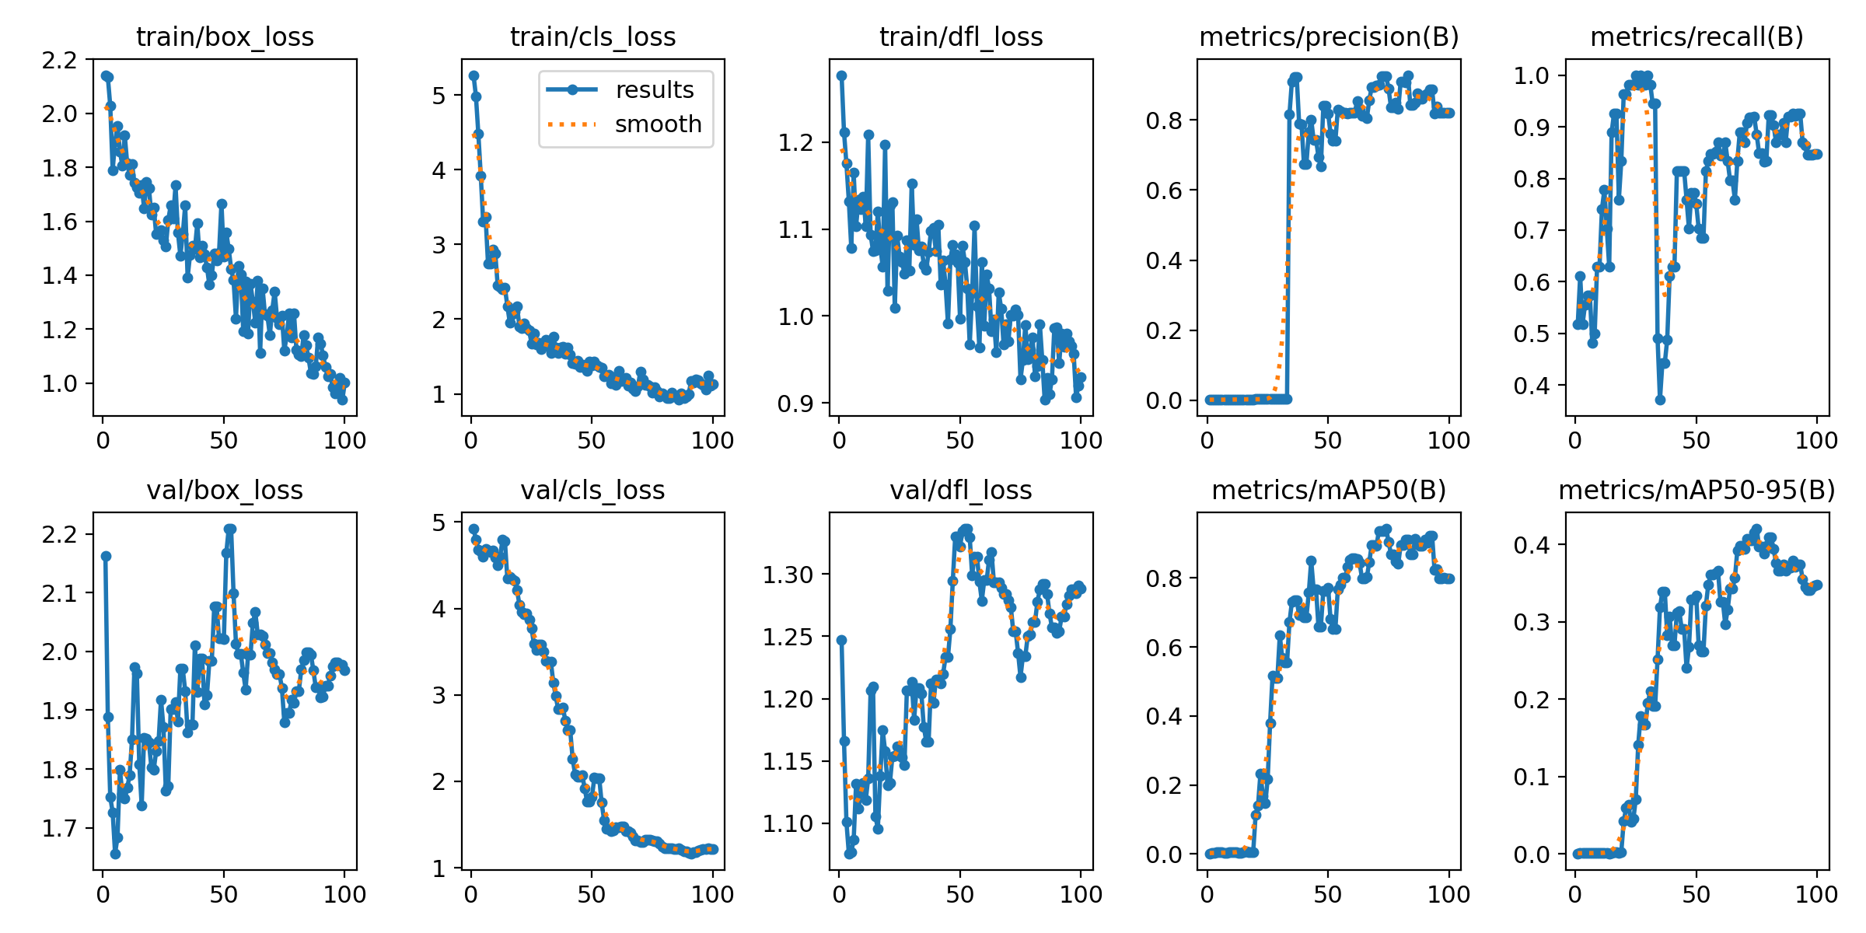
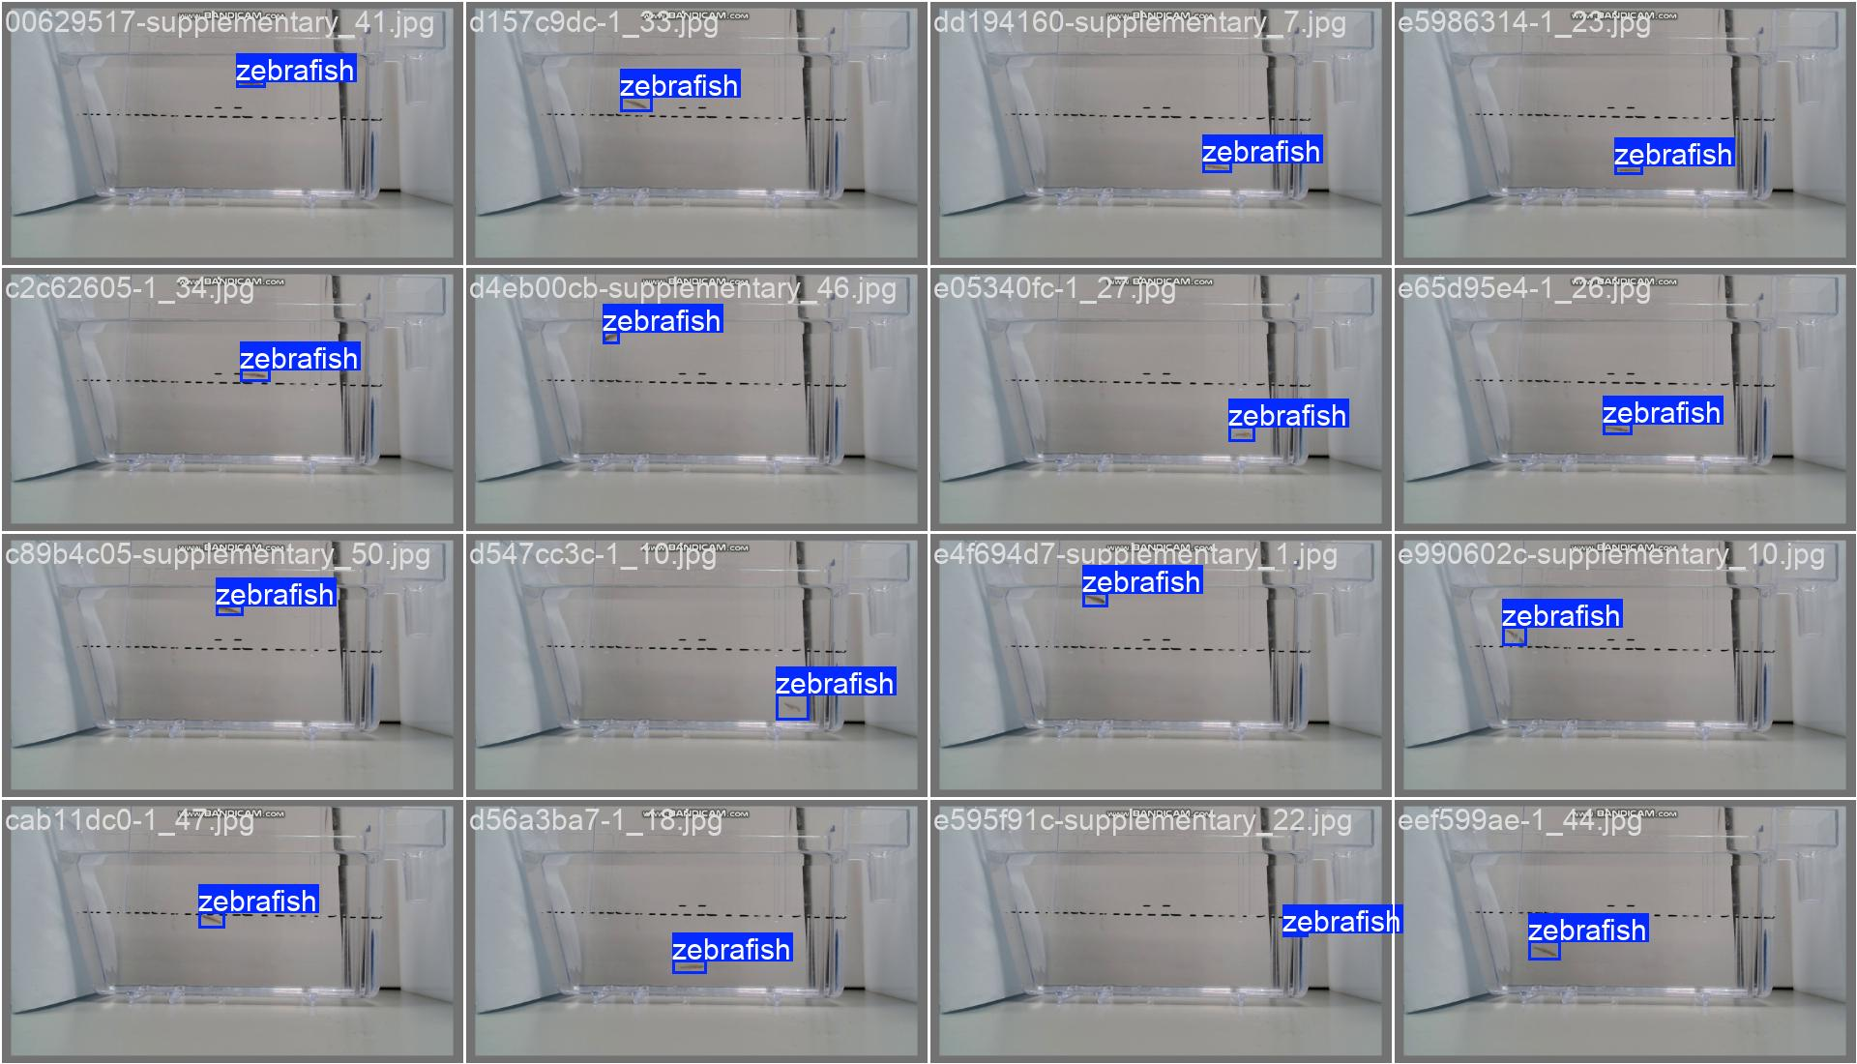
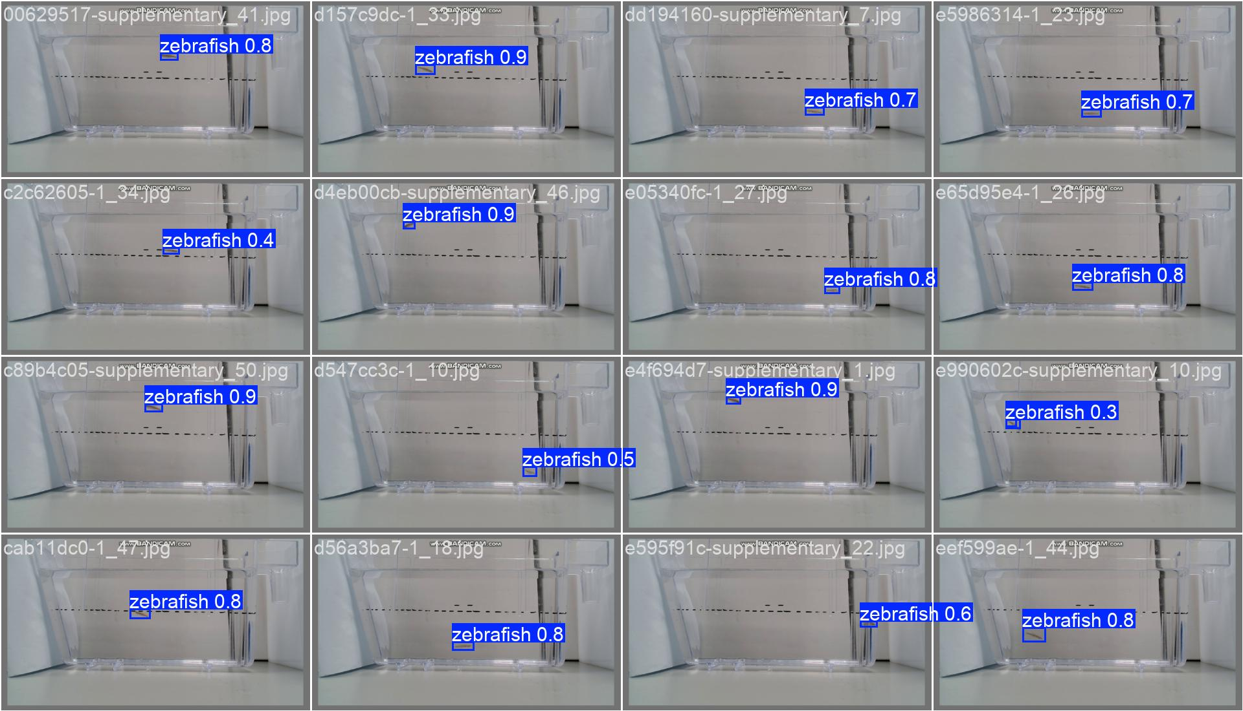
Mydataset 45 pictures
Train 15
task: detect
mode: train
model: yolo11n.yaml
data: D:/Test_File/Code/Zebrafish-NTT-AI-Model/mydataset.yaml
epochs: 100
time: null
patience: 100
batch: 16
imgsz: 640

Slide 11
